Slide 1
Gene-pool Optimal Mixing Evolutionary Algorithms – From Foundations to Applications
Peter A.N. Bosman
Senior Researcher at
Centrum Wiskunde & Informatica (CWI)
(Center for Mathematics and Computer Science)
Life Sciences and Health Research Group
Amsterdam, The Netherlands
Professor of Evolutionary Algorithms at
Delft University of Technology
Department of Software Technology
Algorithmics group
Delft, The Netherlands

Slide 2
Disclosures
Industry (co-)funding
Elekta, ASolutions, Cancer Health Coach, Brocacef Group, Focal Meditech, Xomnia, NVIDIA
Public (co-)funding
NWO-EW, NWO-TTW, KiKa, KWF, TKI-LSH, Maurits en Anna de Kock Stichting, Nijbakker-Morra Stichting

Slide 3
Optimization: A Matter of Perspective
Optimization is key in many (real-world) situations

Slide 4
Optimization: A Matter of Perspective
Optimization is key in many (real-world) situations
Select right tool for the job

Slide 5
Optimization: A Matter of Perspective
Optimization is key in many (real-world) situations
Select right tool for the job
How much known/understood can be crucial

Slide 6
Optimization: A Matter of Perspective
The Black Box Optimization (BBO) perspective:

Slide 7
Optimization: A Matter of Perspective
The Black Box Optimization (BBO) perspective:
Maximize F(x), x ∈ S

Slide 8
Optimization: A Matter of Perspective
The Black Box Optimization (BBO) perspective:
Maximize F(x), x ∈ S
No prior knowledge of F

Slide 9
Optimization: A Matter of Perspective
The Black Box Optimization (BBO) perspective:
Maximize F(x), x ∈ S
No prior knowledge of F
Guess new x and evaluate

Slide 10
Optimization: A Matter of Perspective
The Black Box Optimization (BBO) perspective:
Maximize F(x), x ∈ S
No prior knowledge of F
Guess new x and evaluate
Minimize time (or number of evaluations)

Slide 11
Optimization: A Matter of Perspective
The White Box Optimization (WBO) perspective:

Slide 12
Optimization: A Matter of Perspective
The White Box Optimization (WBO) perspective:
Everything known and suﬃciently understood

Slide 13
Optimization: A Matter of Perspective
The White Box Optimization (WBO) perspective:
Everything known and suﬃciently understood
Use knowledge to your advantage

Slide 14
Optimization: A Matter of Perspective
The White Box Optimization (WBO) perspective:
Everything known and suﬃciently understood
Use knowledge to your advantage
Solve analytically

Slide 15
Optimization: A Matter of Perspective
The White Box Optimization (WBO) perspective:
Everything known and suﬃciently understood
Use knowledge to your advantage
Solve analytically
Build problem-speciﬁc algorithms

Slide 16
Optimization: A Matter of Perspective
WBO typically
faster and/or better than BBO on “simple” problems
optimum guaranteed
not well generalizable
BBO typically
faster and/or better than WBO on “complex” problems
optimum guarantee “problem” (“if time goes to infinity…”)
easily generalizable

Slide 17
Optimization: A Matter of Perspective
Real-world: interesting cases not so simple

Slide 18
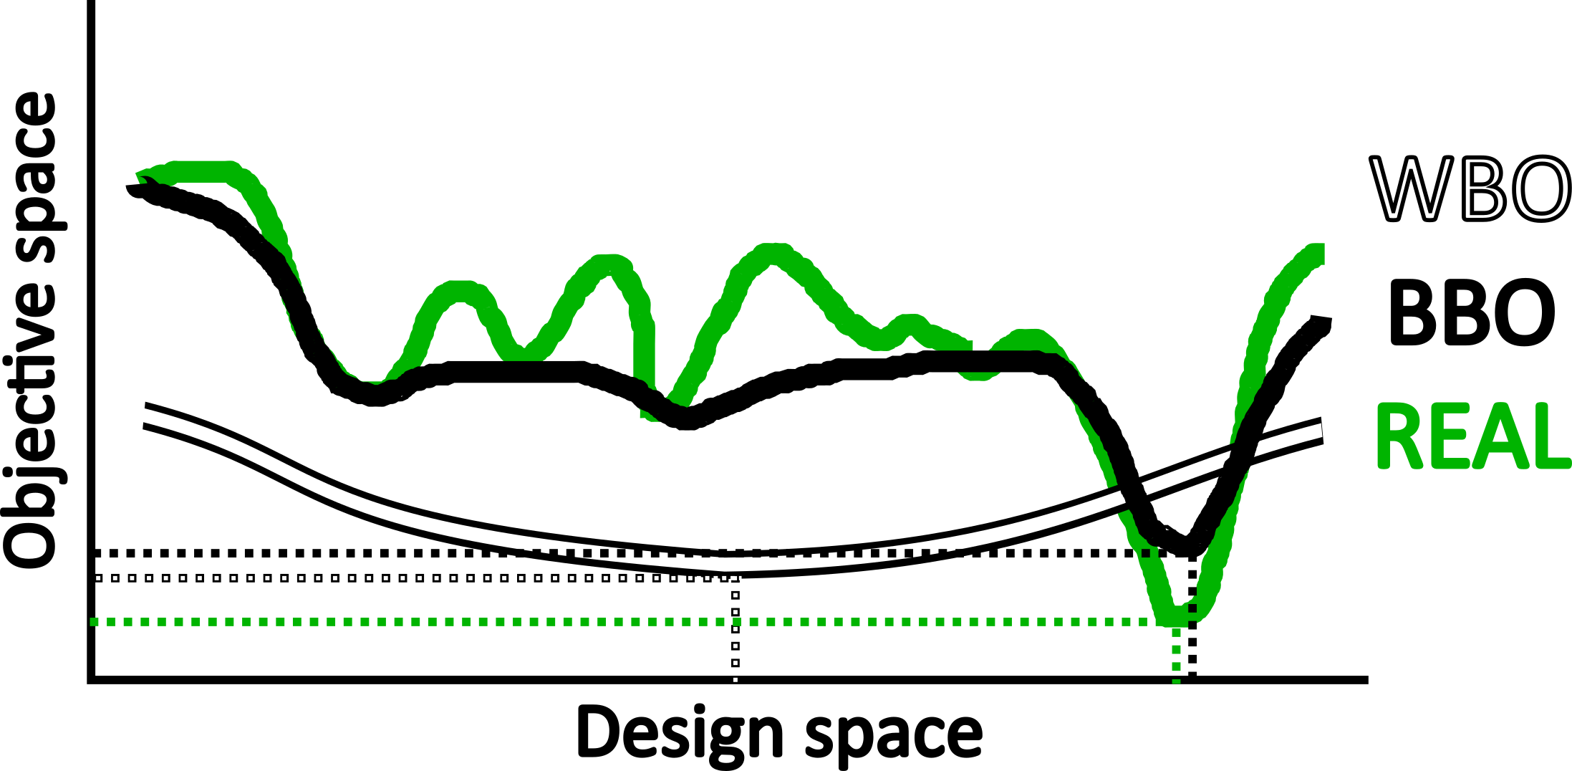
Optimization: A Matter of Perspective
Real-world: interesting cases not so simple
Reason: potential/typical calibration problem

Slide 19
Optimization: A Matter of Perspective
Real-world: interesting cases not so simple
Reason: potential/typical calibration problem
This is also a performance guarantee problem!
Typically bigger for WBO

Slide 20
Optimization: A Matter of Perspective
WBO not always possible
Know everything, understand nothing (suﬃciently)

Slide 21
Optimization: A Matter of Perspective
WBO not always possible
Know everything, understand nothing (suﬃciently)
Fall back on BBO

Slide 22
Optimization: A Matter of Perspective
WBO not always possible
Know everything, understand nothing (suﬃciently)
Fall back on BBO
Sometimes possibilities in between

Slide 23
Optimization: A Matter of Perspective
WBO not always possible
Know everything, understand nothing (suﬃciently)
Fall back on BBO
Sometimes possibilities in between
⇒
Grey Box Optimization (GBO) perspective

Slide 24
Optimization: A Matter of Perspective
Speciﬁc GBO:

Slide 25
Optimization: A Matter of Perspective
Speciﬁc GBO:
Partial evaluations

Slide 26
Optimization: A Matter of Perspective
Speciﬁc GBO:
Partial evaluations
Assume only k of ℓ variables change

Slide 27
Optimization: A Matter of Perspective
Speciﬁc GBO:
Partial evaluations
Assume only k of ℓ variables change
∆F computable more eﬃciently

Slide 28
Optimization: A Matter of Perspective
Speciﬁc GBO:
Partial evaluations
Assume only k of ℓ variables change
∆F computable more eﬃciently
For example: in O(k) instead of O(ℓ) time

Slide 29
Optimization: A Matter of Perspective
Speciﬁc GBO:
Partial evaluations
Assume only k of ℓ variables change
∆F computable more eﬃciently
For example: in O(k) instead of O(ℓ) time
Note: does not mean trivial or separable problems!

Slide 30
Optimization in practice
Ultimately, in real world, often (simply) need to
do something good, and
do it fast

Slide 31
Optimization in practice
Ultimately, in real world, often (simply) need to
do something good, and
do it fast
Flexible, powerful baseline optimization technology, aaimed at BBO/GBO, is potentially very useful!

Slide 32
Optimization in practice
Ultimately, in real world, often (simply) need to
do something good, and
do it fast
Flexible, powerful baseline optimization technology, aaimed at BBO/GBO, is potentially very useful!
Particular focus: evolutionary algorithms

Slide 33
Evolutionary Algorithms
Three main ingredients:

Slide 34
Evolutionary Algorithms
Three main ingredients:
A set/population of (candidate) solutions

Slide 35
Evolutionary Algorithms
Three main ingredients:
A set/population of (candidate) solutions
Selection (to select better solutions)

Slide 36
Evolutionary Algorithms
Three main ingredients:
A set/population of (candidate) solutions
Selection (to select better solutions)
Variation (to combine and alter selected solutions)

Slide 37
Evolutionary Algorithms
Three main ingredients:
A set/population of (candidate) solutions
Selection (to select better solutions)
Variation (to combine and alter selected solutions)

Slide 38
Blind EAs
Most early EAs were “blind”

Slide 39
Blind EAs
Most early EAs were “blind”
No attention to matching variation to problem structure

Slide 40
Blind EAs
Most early EAs were “blind”
No attention to matching variation to problem structure
Classical variation examples (simple genetic algorithm)
(J. Holland, MIT Press, 1975)

Slide 41
De-blinding EAs
“Blindness” can lead to inefficiency

Slide 42
De-blinding EAs
“Blindness” can lead to inefficiency
Population size $n$ to find optimum scales poorly
$$n= Ω\left({\left(2−ε\right)}^{ℓ}\right) for some 0<ε<1$$
(D. Thierens et al., Proc. ICGA, 1993)

Slide 43
De-blinding EAs
“Blindness” can lead to inefficiency
Population size $n$ to find optimum scales poorly
$$n= Ω\left({\left(2−ε\right)}^{ℓ}\right) for some 0<ε<1$$
(D. Thierens et al., Proc. ICGA, 1993)
If variation is spot on, the story is very different
$$n= θ\left(\sqrt{ℓ}\right)$$
(G. Harik et al., Proc. ICGA, 1997)

Slide 44
De-blinding EAs
“Blindness” can lead to inefficiency
Population size $n$ to find optimum scales poorly
$$n= Ω\left({\left(2−ε\right)}^{ℓ}\right) for some 0<ε<1$$
(D. Thierens et al., Proc. ICGA, 1993)
If variation is spot on, the story is very different
$$n= θ\left(\sqrt{ℓ}\right)$$
(G. Harik et al., Proc. ICGA, 1997)
Core EA research concerns (automatically) being in the second situation

Slide 45
(Linkage-) Model-based EAs
Model-based EAs
Linkage learning = building linkage models
Which variables to consider jointly in variation
Automatically (i.e., online)
Manually (i.e., problem-specific)

Slide 46
(Linkage-) Model-based EAs
Model-based EAs
Assumption: problems are somehow structured
Linkage learning = building linkage models
Which variables to consider jointly in variation
Automatically (i.e., online)
Manually (i.e., problem-specific)

Slide 47
(Linkage-) Model-based EAs
Model-based EAs
Assumption: problems are somehow structured
Learn and exploit structure (during optimization)
Linkage learning = building linkage models
Which variables to consider jointly in variation
Automatically (i.e., online)
Manually (i.e., problem-specific)

Slide 48
(Linkage-) Model-based EAs
Model-based EAs
Assumption: problems are somehow structured
Learn and exploit structure (during optimization)
Preferable to enumeration or random sampling
Linkage learning = building linkage models
Which variables to consider jointly in variation
Automatically (i.e., online)
Manually (i.e., problem-specific)

Slide 49
(Linkage-) Model-based EAs
Model-based EAs
Assumption: problems are somehow structured
Learn and exploit structure (during optimization)
Preferable to enumeration or random sampling
Linkage learning = building linkage models

Slide 50
(Linkage-) Model-based EAs
Model-based EAs
Assumption: problems are somehow structured
Learn and exploit structure (during optimization)
Preferable to enumeration or random sampling
Linkage learning = building linkage models
Which variables to consider jointly in variation

Slide 51
(Linkage-) Model-based EAs
Model-based EAs
Assumption: problems are somehow structured
Learn and exploit structure (during optimization)
Preferable to enumeration or random sampling
Linkage learning = building linkage models
Which variables to consider jointly in variation
Automatically (i.e., online)

Slide 52
(Linkage-) Model-based EAs
Model-based EAs
Assumption: problems are somehow structured
Learn and exploit structure (during optimization)
Preferable to enumeration or random sampling
Linkage learning = building linkage models
Which variables to consider jointly in variation
Automatically (i.e., online)
Manually (i.e., problem-specific)

Slide 53
Optimal Mixing Evolutionary Algorithms
Selection and variation in Optimal Mixing operator

Slide 54
Optimal Mixing Evolutionary Algorithms
Selection and variation in Optimal Mixing operator
Family Of Subsets (FOS) identifies linkage sets

Slide 55
Optimal Mixing Evolutionary Algorithms
Selection and variation in Optimal Mixing operator
Family Of Subsets (FOS) identifies linkage sets
Optimal Mixing (OM) exploits linkage sets

Slide 56
Optimal Mixing Evolutionary Algorithms
Selection and variation in Optimal Mixing operator
Family Of Subsets (FOS) identifies linkage sets
Optimal Mixing (OM) exploits linkage sets
Better, or equal, solutions immediately accepted

Slide 57
Optimal Mixing Evolutionary Algorithms
Selection and variation in Optimal Mixing operator
Family Of Subsets (FOS) identifies linkage sets
Optimal Mixing (OM) exploits linkage sets
Better, or equal, solutions immediately accepted
Independent from “noise” from other solution parts

Slide 58
Optimal Mixing Evolutionary Algorithms
Selection and variation in Optimal Mixing operator
Family Of Subsets (FOS) identifies linkage sets
Optimal Mixing (OM) exploits linkage sets
Better, or equal, solutions immediately accepted
Independent from “noise” from other solution parts
≈ greedy improvement of solutions

Slide 59
Optimal Mixing Evolutionary Algorithms
Selection and variation in Optimal Mixing operator
Family Of Subsets (FOS) identifies linkage sets
Optimal Mixing (OM) exploits linkage sets
Better, or equal, solutions immediately accepted
Independent from “noise” from other solution parts
≈ greedy improvement of solutions
Most used variant is GOMEA:
Gene-pool Optimal Mixing Evolutionary Algorithm
(Thierens and Bosman, Proc. GECCO, 2011)

Slide 60
GOMEA: a Modern Model-based EA
Population
AAAAAAAAAA
BBBBBBBBBB
CCCCCCCCCC
DDDDDDDDDD
Linkage sets
{0, 1, 2}
{3}
{4, 5}
{6, 7, 8, 9}

Slide 61
GOMEA: a Modern Model-based EA
Population
AAAAAAAAAA
BBBBBBBBBB
CCCCCCCCCC
DDDDDDDDDD
Linkage sets
{0, 1, 2}
{3}
{4, 5}
{6, 7, 8, 9}
Apply GOM to AAAAAAAAAA
1. Current = AAAAAAAAAA; linkage set = {0, 1, 2};
Donor = DDDDDDDDDD; Test = DDDAAAAAAA ⇒ improvement
2. Current = DDDAAAAAAA; linkage set = {3};
Donor = CCCCCCCCCC; Test = DDDCAAAAAA ⇒ no improvement
3. Current = DDDAAAAAAA; linkage set = {4, 5};
Donor = AAAAAAAAAA; current solution unchanged ⇒ skip
4. Current = DDDAAAAAAA; linkage set = {6, 7, 8, 9};
Donor = BBBBBBBBBB; Test = DDDAAABBBB ⇒ improvement
C
O

Slide 62
GOMEA: a Modern Model-based EA
Population
AAAAAAAAAA
BBBBBBBBBB
CCCCCCCCCC
DDDDDDDDDD
Linkage sets
{0, 1, 2}
{3}
{4, 5}
{6, 7, 8, 9}
Apply GOM to AAAAAAAAAA
1. Current = AAAAAAAAAA; Linkage set = {0, 1, 2};
Donor = DDDDDDDDDD; Test = DDDAAAAAAA ⇒ improvement
2. Current = DDDAAAAAAA; linkage set = {3};
Donor = CCCCCCCCCC; Test = DDDCAAAAAA ⇒ no improvement
3. Current = DDDAAAAAAA; linkage set = {4, 5};
Donor = AAAAAAAAAA; current solution unchanged ⇒ skip
4. Current = DDDAAAAAAA; linkage set = {6, 7, 8, 9};
Donor = BBBBBBBBBB; Test = DDDAAABBBB ⇒ improvement
C
O

Slide 63
GOMEA: a Modern Model-based EA
Population
AAAAAAAAAA
BBBBBBBBBB
CCCCCCCCCC
DDDDDDDDDD
Linkage sets
{0, 1, 2}
{3}
{4, 5}
{6, 7, 8, 9}
Apply GOM to AAAAAAAAAA
1. Current = AAAAAAAAAA; Linkage set = {0, 1, 2};
Donor = DDDDDDDDDD; Test = DDDAAAAAAA ⇒ improvement
2. Current = DDDAAAAAAA; Linkage set = {3};
Donor = CCCCCCCCCC; Test = DDDCAAAAAA ⇒ no improvement
3. Current = DDDAAAAAAA; linkage set = {4, 5};
Donor = AAAAAAAAAA; current solution unchanged ⇒ skip
4. Current = DDDAAAAAAA; linkage set = {6, 7, 8, 9};
Donor = BBBBBBBBBB; Test = DDDAAABBBB ⇒ improvement
C
O

Slide 64
GOMEA: a Modern Model-based EA
Population
AAAAAAAAAA
BBBBBBBBBB
CCCCCCCCCC
DDDDDDDDDD
Linkage sets
{0, 1, 2}
{3}
{4, 5}
{6, 7, 8, 9}
Apply GOM to AAAAAAAAAA
1. Current = AAAAAAAAAA; Linkage set = {0, 1, 2};
Donor = DDDDDDDDDD; Test = DDDAAAAAAA ⇒ improvement
2. Current = DDDAAAAAAA; Linkage set = {3};
Donor = CCCCCCCCCC; Test = DDDCAAAAAA ⇒ no improvement
3. Current = DDDAAAAAAA; Linkage set = {4, 5};
Donor = AAAAAAAAAA; Current solution unchanged ⇒ skip
4. Current = DDDAAAAAAA; linkage set = {6, 7, 8, 9};
Donor = BBBBBBBBBB; Test = DDDAAABBBB ⇒ improvement
C
O

Slide 65
GOMEA: a Modern Model-based EA
Population
AAAAAAAAAA
BBBBBBBBBB
CCCCCCCCCC
DDDDDDDDDD
Linkage sets
{0, 1, 2}
{3}
{4, 5}
{6, 7, 8, 9}
Apply GOM to AAAAAAAAAA
1. Current = AAAAAAAAAA; Linkage set = {0, 1, 2};
Donor = DDDDDDDDDD; Test = DDDAAAAAAA ⇒ improvement
2. Current = DDDAAAAAAA; Linkage set = {3};
Donor = CCCCCCCCCC; Test = DDDCAAAAAA ⇒ no improvement
3. Current = DDDAAAAAAA; Linkage set = {4, 5};
Donor = AAAAAAAAAA; Current solution unchanged ⇒ skip
4. Current = DDDAAAAAAA; Linkage set = {6, 7, 8, 9};
Donor = BBBBBBBBBB; Test = DDDAAABBBB ⇒ improvement
C
O

Slide 66
GOMEA: a Modern Model-based EA
Population
AAAAAAAAAA
BBBBBBBBBB
CCCCCCCCCC
DDDDDDDDDD
Linkage sets
{0, 1, 2}
{3}
{4, 5}
{6, 7, 8, 9}
Apply GOM to AAAAAAAAAA
1. Current = AAAAAAAAAA; Linkage set = {0, 1, 2};
Donor = DDDDDDDDDD; Test = DDDAAAAAAA ⇒ improvement
2. Current = DDDAAAAAAA; Linkage set = {3};
Donor = CCCCCCCCCC; Test = DDDCAAAAAA ⇒ no improvement
3. Current = DDDAAAAAAA; Linkage set = {4, 5};
Donor = AAAAAAAAAA; Current solution unchanged ⇒ skip
4. Current = DDDAAAAAAA; Linkage set = {6, 7, 8, 9};
Donor = BBBBBBBBBB; Test = DDDAAABBBB ⇒ improvement
Offspring = DDDAAABBBB
Current = DDDAAABBBB; Was changed ⇒ skip FI

Slide 67
GOMEA: a Modern Model-based EA
Gene-pool Optimal Mixing EA (GOMEA)

Slide 68
GOMEA: a Modern Model-based EA
Gene-pool Optimal Mixing EA (GOMEA)
Generate n offspring

Slide 69
GOMEA: a Modern Model-based EA
Gene-pool Optimal Mixing EA (GOMEA)
Generate n offspring
Apply GOM (+FI) to each pop. member

Slide 70
GOMEA: a Modern Model-based EA
Gene-pool Optimal Mixing EA (GOMEA)
Generate n offspring
Apply GOM (+FI) to each pop. member
Replace parents with offspring

Slide 71
GOMEA: a Modern Model-based EA
Gene-pool Optimal Mixing EA (GOMEA)
Generate n offspring
Apply GOM (+FI) to each pop. member
Replace parents with offspring
P3 is a variant of GOMEA

Slide 72
GOMEA: a Modern Model-based EA
Gene-pool Optimal Mixing EA (GOMEA)
Generate n offspring
Apply GOM (+FI) to each pop. member
Replace parents with offspring
P3 is a variant of GOMEA
Different population management scheme

Slide 73
GOMEA: a Modern Model-based EA
Gene-pool Optimal Mixing EA (GOMEA)
Generate n offspring
Apply GOM (+FI) to each pop. member
Replace parents with offspring
P3 is a variant of GOMEA
Different population management scheme
DSMGA-II is a close relative of GOMEA

Slide 74
GOMEA Variants
LTGA is an instance of GOMEA
LTGA = LT-GOMEA
LTGA = LT-GOMEA
P3 is a variant of LTGA
Different population management scheme

Slide 75
GOMEA Variants
LTGA is an instance of GOMEA
LTGA = LT-GOMEA
LTGA builds a Linkage Tree (LT) as the FOS (LT-FOS)
Different population management scheme

Slide 76
GOMEA Variants
LTGA is an instance of GOMEA
LTGA = LT-GOMEA
LTGA builds a Linkage Tree (LT) as the FOS (LT-FOS)
Agglomerative, or bottom-up, hierarchical clustering
Different population management scheme

Slide 77
GOMEA Variants
LTGA is an instance of GOMEA
LTGA = LT-GOMEA
LTGA builds a Linkage Tree (LT) as the FOS (LT-FOS)
Agglomerative, or bottom-up, hierarchical clustering
Distance for clustering = inverted/negated dependence

Slide 78
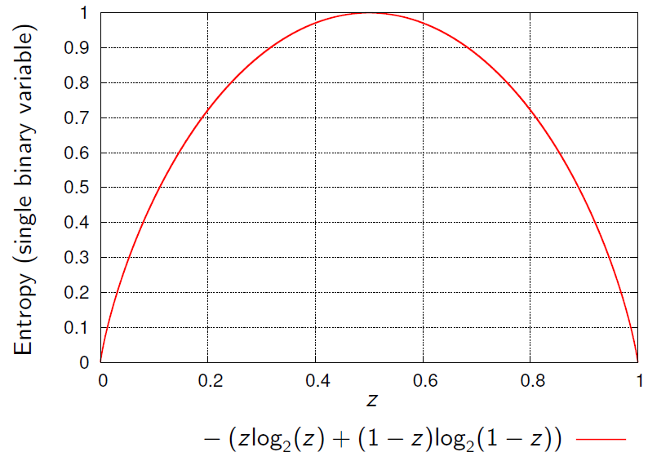
GOMEA Variants
LTGA is an instance of GOMEA
LTGA = LT-GOMEA
LTGA builds a Linkage Tree (LT) as the FOS (LT-FOS)
Agglomerative, or bottom-up, hierarchical clustering
Distance for clustering = inverted/negated dependence
Dependence: mutual information

Slide 79
GOMEA Variants
LTGA is an instance of GOMEA
LTGA = LT-GOMEA
LTGA builds a Linkage Tree (LT) as the FOS (LT-FOS)
Agglomerative, or bottom-up, hierarchical clustering
Distance for clustering = inverted/negated dependence
Dependence: mutual information
O(nℓ²) (ℓ: #variables, n: population size)Different population management scheme

Slide 80
GOMEA Variants
LTGA is an instance of GOMEA
LTGA = LT-GOMEA
LTGA builds a Linkage Tree (LT) as the FOS (LT-FOS)
Agglomerative, or bottom-up, hierarchical clustering
Distance for clustering = inverted/negated dependence
Dependence: mutual information
O(nℓ²) (ℓ: #variables, n: population size)
O(nℓ) evaluations per generation → O(ℓ) time per evaluation

Slide 81
Linkage Tree FOS (LT-FOS)
Example of LT-FOS in 2nd generation on Trap-5:
Note:
Variables dependent AND independent
≈ Path through dependence space, univariate to joint
7 5 8 6 9 0 3 2 4 1
7 5 8 6 9
5 8 6 9
0 3 2 4 1
5 8 6
0 3 2 4
5 8
0 3
2 4
7
5
8
6
9
0
3
2
4
1

Slide 82
Linkage Tree FOS (LT-FOS)
Example of LT-FOS in 2nd generation on Trap-5:
Note:
Variables dependent AND independent
≈ Path through dependence space, univariate to joint
7 5 8 6 9 0 3 2 4 1
7 5 8 6 9
5 8 6 9
0 3 2 4 1
5 8 6
0 3 2 4
5 8
0 3
2 4
7
5
8
6
9
0
3
2
4
1

Slide 83
Population Size No More
Optimal population size hard/impossible

Slide 84
Population Size No More
1 | 2 | 3 | 4 | 5
X
Optimal population size hard/impossible
Interleaved Multi-start Scheme
Based on Harik & Lobo (1999)
Population size of start i with size b*2^{i}
Start i runs every g generations of start i-1
Terminate start i if start i+1 is doing better
Extensions for multi-objective optimization

Slide 85
GOMEA
GOMEA = EA + LS (+ ML)

Slide 86
GOMEA
GOMEA = EA + LS (+ ML)
Many more evaluations per solution/generation

Slide 87
GOMEA
GOMEA = EA + LS (+ ML)
Many more evaluations per solution/generation
Consequently: only relatively small populations

Slide 88
GOMEA
GOMEA = EA + LS (+ ML)
Many more evaluations per solution/generation
Consequently: only relatively small populations
Compatible with GBO: exploit partial evaluations

Slide 89
GOMEA
GOMEA = EA + LS (+ ML)
Many more evaluations per solution/generation
Consequently: only relatively small populations
Compatible with GBO: exploit partial evaluations
Potentially powerful, versatile tool for (real-world) +optimization

Slide 90
GOMEA
GOMEA = EA + LS (+ ML)
Many more evaluations per solution/generation
Consequently: only relatively small populations
Compatible with GBO: exploit partial evaluations
Potentially powerful, versatile tool for (real-world) +optimization
In real-world may well
Be able to do partial evaluations
Have a good guess of a useful linkage model

Slide 91
Binary GOMEA
Introduced originally for binary variables
(As LTGA: Thierens, Proc. PPSN, 2010)
(As GOMEA: Thierens and Bosman, Proc. GECCO, 2011)

Slide 92
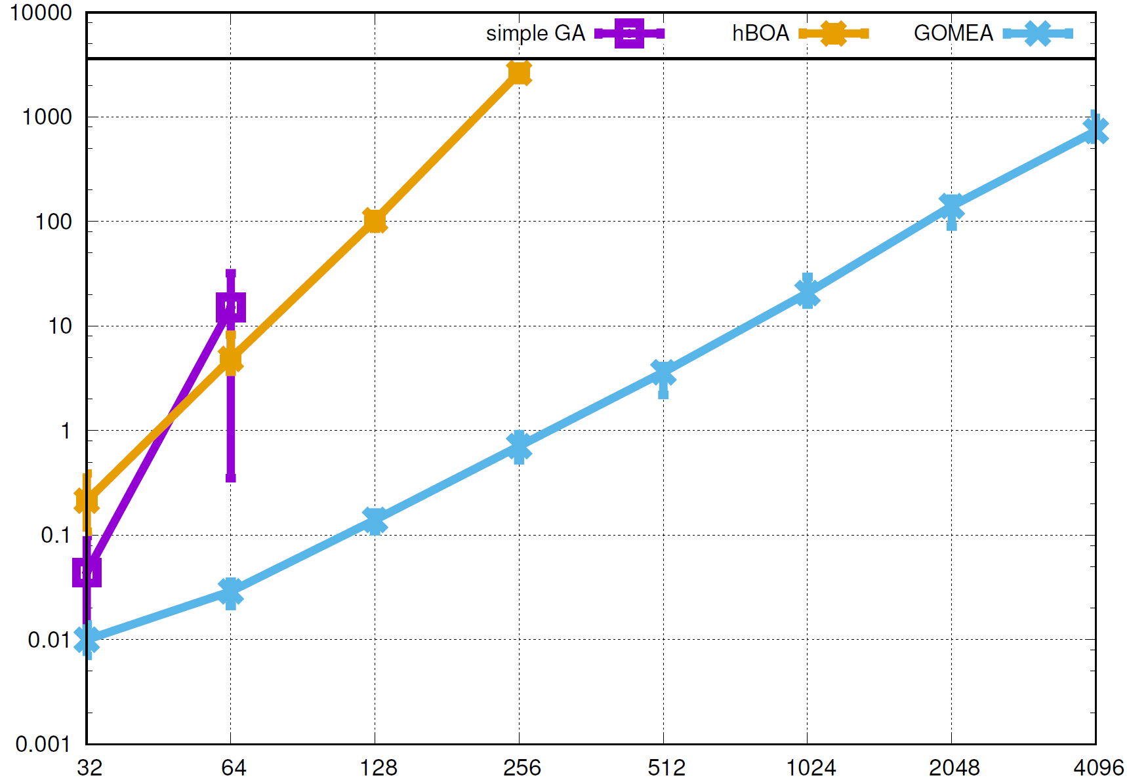
Binary GOMEA
Hierarchical if-and-only if (HIFF) in BBO setting
Time to optimum (seconds on 2.8 GHz AMD)
Number of variables

Slide 93
Fundamental GOMEA Extensions
Categorical integer variables (6,1,5,3,1,2,3)
(Luong, La Poutré and Bosman, Proc. GECCO, 2015)
Permutations (4,1,3,2,5,6,0)
(Bosman, Luong and Thierens, Proc. GECCO, 2016)
Real-valued variables (0.315,5.123,-6.123,12.22)
(Bouter et al., Proc. GECCO, 2017)

Slide 94
Fundamental GOMEA Extensions
Real-valued GOMEA is “framework of its own”
Can be combined with any type of EA
Update and sampling mechanism for each block
So far, we combined with
AMaLGaM
CMA-ES
(Bouter et al., in preparation (partially (AMaLGaM part) in proc. GECCO, 2017))

Slide 95
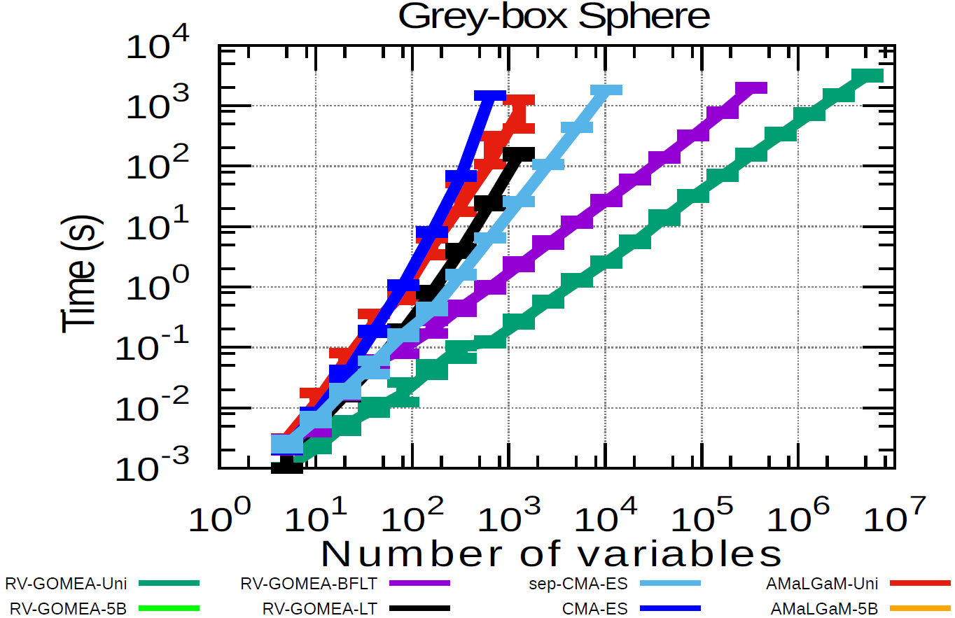
Real-Valued GOMEA

Slide 96
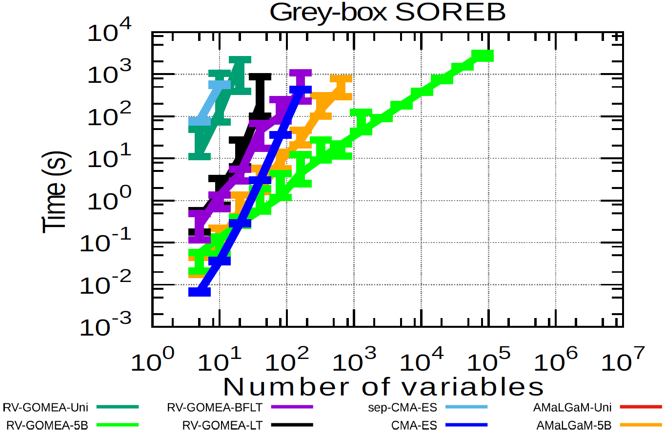
Real-Valued GOMEA

Slide 97
Fundamental GOMEA Extensions
Special case: program trees
(Virgolin et al., Proc. GECCO, 2017)
Use to optimize functions
Minimize error on training data, e.g.: $\min_{α∈ℤ}\left\{\frac{1}{N}\sum_{i=0}^{N−1}{{\left(y^{i}−f_{α}\left(x^{i}\right)\right)}^{2}}\right\}$
Definition of machine learning
Form of explainable Artificial Intelligence (AI)
If
>
/
7
X₀
X₁
X₂
10

Slide 98
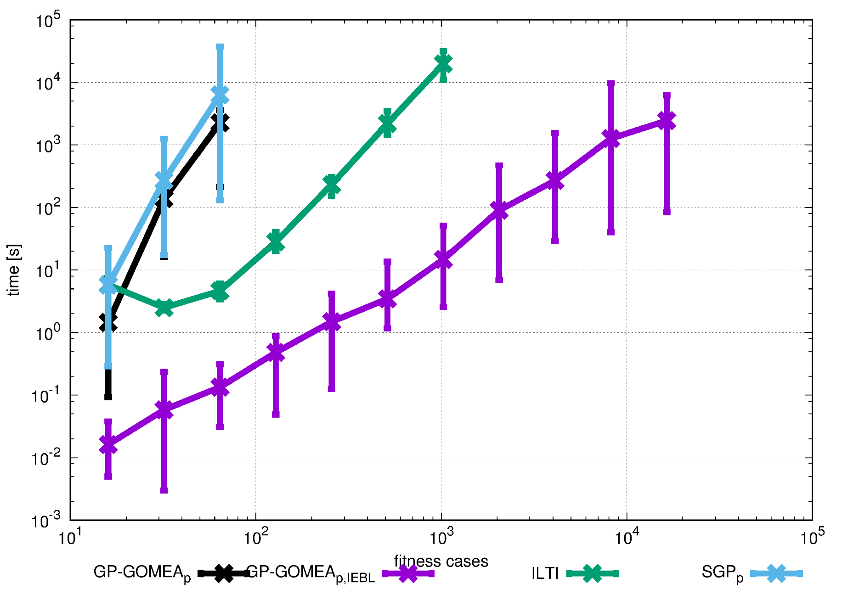
Genetic Programming GOMEA
Some scalability results for binary functions
(Virgolin et al., Proc. GECCO, 2017)

Slide 99
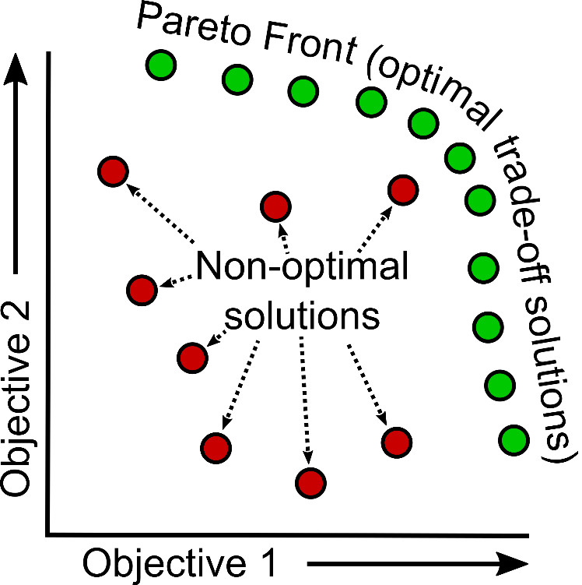
Fundamental GOMEA Extensions
Multi-objective optimization
EAs state-of-the-art

Slide 100
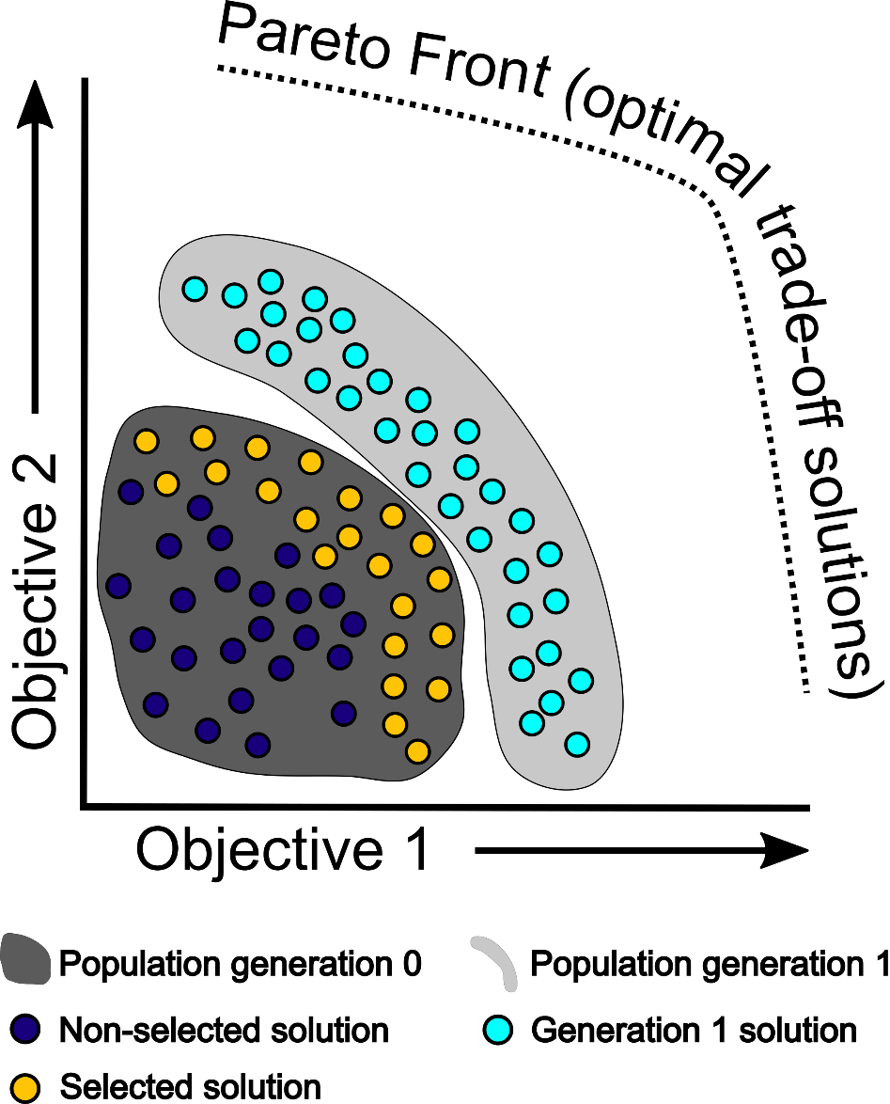
Fundamental GOMEA Extensions
Multi-objective EAs

Slide 101
Fundamental GOMEA Extensions
Multi-objective binary GOMEA
(Luong, La Poutré, Bosman, Proc. GECCO, 2014)
Multi-objective integer GOMEA
(Luong et al., Proc. IEEE PES GM, 2015)
Multi-objective real-valued GOMEA
(Bouter et al., Proc. GECCO, 2017)
Many-objective GOMEA
(Luong, Alderliesten, Bosman, Proc. GECCO, 2018)

Slide 102
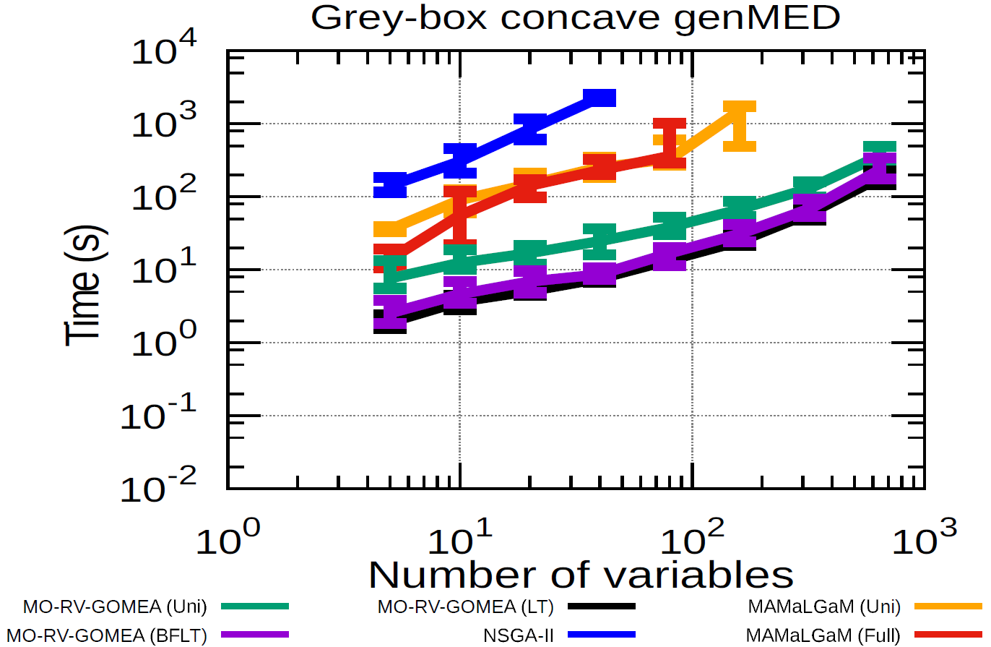
MO Real-Valued GOMEA

Slide 103
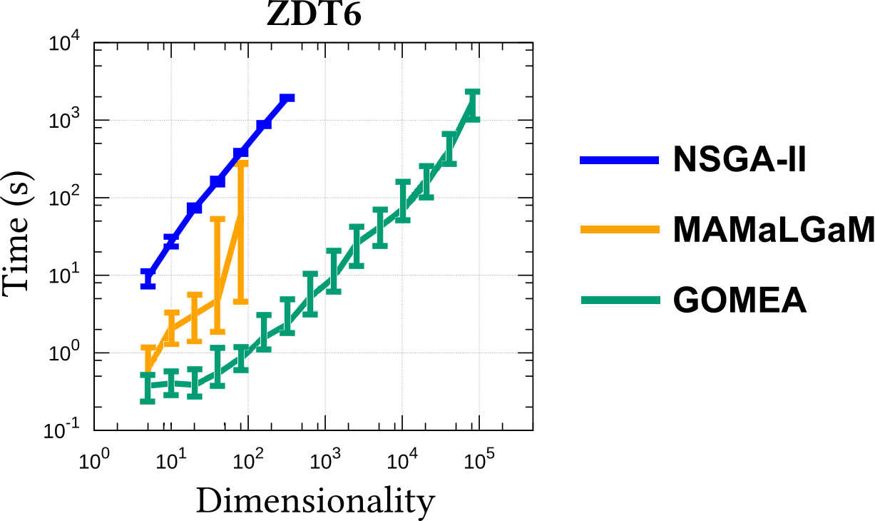
MO Real-Valued GOMEA
(GBO)

Slide 104
Real-world applications
Benchmark problems are nice for comparisons

Slide 105
Real-world applications
Benchmark problems are nice for comparisons
What about real real-world applications?
Radiation therapy

Slide 106
Real-world applications
Benchmark problems are nice for comparisons
What about real real-world applications?
Radiation therapy
Broad use for optimization (and learning)

Slide 107
Real-world applications
Benchmark problems are nice for comparisons
What about real real-world applications?
Radiation therapy
Broad use for optimization (and learning)
Selected examples and (first) results

Slide 108
High-Dose-Rate Prostate Brachytherapy
Automated
.radiation
.treatment
.planning
Current focus on
.brachytherapy
.(prostate)
Isodose lines in % of planning-aim dose

Slide 109
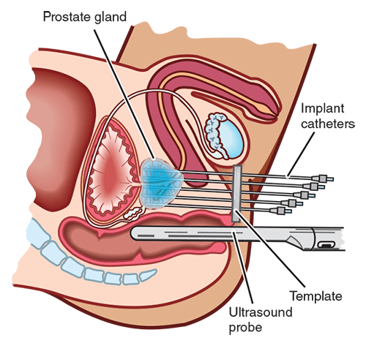
High-Dose-Rate Prostate Brachytherapy
Automated
.radiation
.treatment
.planning
Current focus on
.brachytherapy
.(prostate)
Isodose lines in % of planning-aim dose

Slide 110
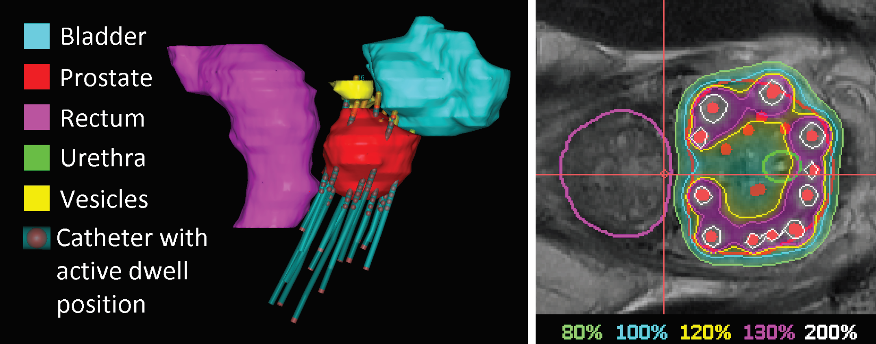
GOMEA for brachytherapy

Slide 111
GOMEA for brachytherapy
Isodose lines in % of planning-aim dose
0.03 0.53 0.98 1.32 …………………………………. 0.99 1.63 1.98 2.02

Slide 112
Semi-automatic RT planning
Find intuitive trade-off in low-dimensional space that captures variation of evaluation criteria that planners are interested in
Special interest: group-wise worst-case models
Targets: Least Coverage Index (LCI)
OARs: Least Sparing Index (LSI)

Slide 113
GOMEA for brachytherapy

Slide 114
GOMEA for brachytherapy
98 – 95 = 3
Example:
$V_{100\%}^{prostate}=$98%
$V_{80\%}^{vesicles} =$96%

Slide 115
GOMEA for brachytherapy
98 – 95 = 3
96 – 95 = 1
Example:
$V_{100\%}^{prostate}=$98%
$V_{80\%}^{vesicles} =$96%

Slide 116
GOMEA for brachytherapy
98 – 95 = 3
96 – 95 = 1
Example:
$V_{100\%}^{prostate}=$98%
$V_{80\%}^{vesicles} =$96%
min{3,1} = 1%

Slide 117
GOMEA for brachytherapy
LCI LSI
0.03 0.53 0.98 1.32 …………………………………. 0.99 1.63 1.98 2.02 0.91 1.21

Slide 118
GOMEA for brachytherapy
LCI LSI
0.03 0.53 0.98 1.32 …………………………………. 0.99 1.63 1.98 2.02 0.91 1.21
0.41 0.71 0.18 0.98 …………………………………. 1.05 0.83 2.51 1.14 1.31 0.01
0.18 0.21 1.31 0.54 …………………………………. 3.14 2.21 0.91 1.31 1.41 -0.51
0.62 0.99 0.43 1.42 …………………………………. 1.31 1.03 1.33 1.02 1.11 1.31
1.33 0.21 1.90 0.88 …………………………………. 1.54 0.94 0.91 1.11 0.55 2.01
………………………………….…………………………………………………………………………. .……. ……..

Slide 119
GOMEA for brachytherapy
LCI LSI
0.03 0.53 0.98 1.32 …………………………………. 0.99 1.63 1.98 2.02 0.91 1.21
0.41 0.71 0.18 0.98 …………………………………. 1.05 0.83 2.51 1.14 1.31 0.01
0.18 0.21 1.31 0.54 …………………………………. 3.14 2.21 0.91 1.31 1.41 -0.51
0.62 0.99 0.43 1.42 …………………………………. 1.31 1.03 1.33 1.02 1.11 1.31
1.33 0.21 1.90 0.88 …………………………………. 1.54 0.94 0.91 1.11 0.55 2.01
………………………………….…………………………………………………………………………. .……. ……..

Slide 120
GOMEA for brachytherapy
Figure out dependencies between variables
LCI LSI
0.03 0.53 0.98 1.32 …………………………………. 0.99 1.63 1.98 2.02 0.91 1.21
0.41 0.71 0.18 0.98 …………………………………. 1.05 0.83 2.51 1.14 1.31 0.01
0.18 0.21 1.31 0.54 …………………………………. 3.14 2.21 0.91 1.31 1.41 -0.51
0.62 0.99 0.43 1.42 …………………………………. 1.31 1.03 1.33 1.02 1.11 1.31
1.33 0.21 1.90 0.88 …………………………………. 1.54 0.94 0.91 1.11 0.55 2.01
………………………………….…………………………………………………………………………. .……. ……..

Slide 121
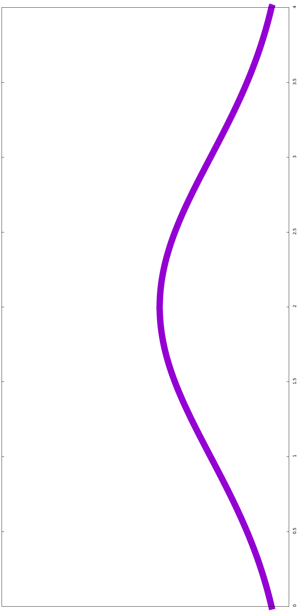
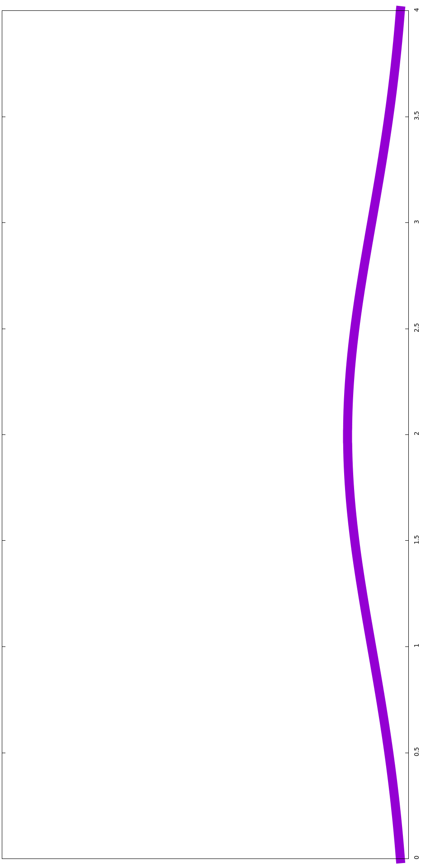
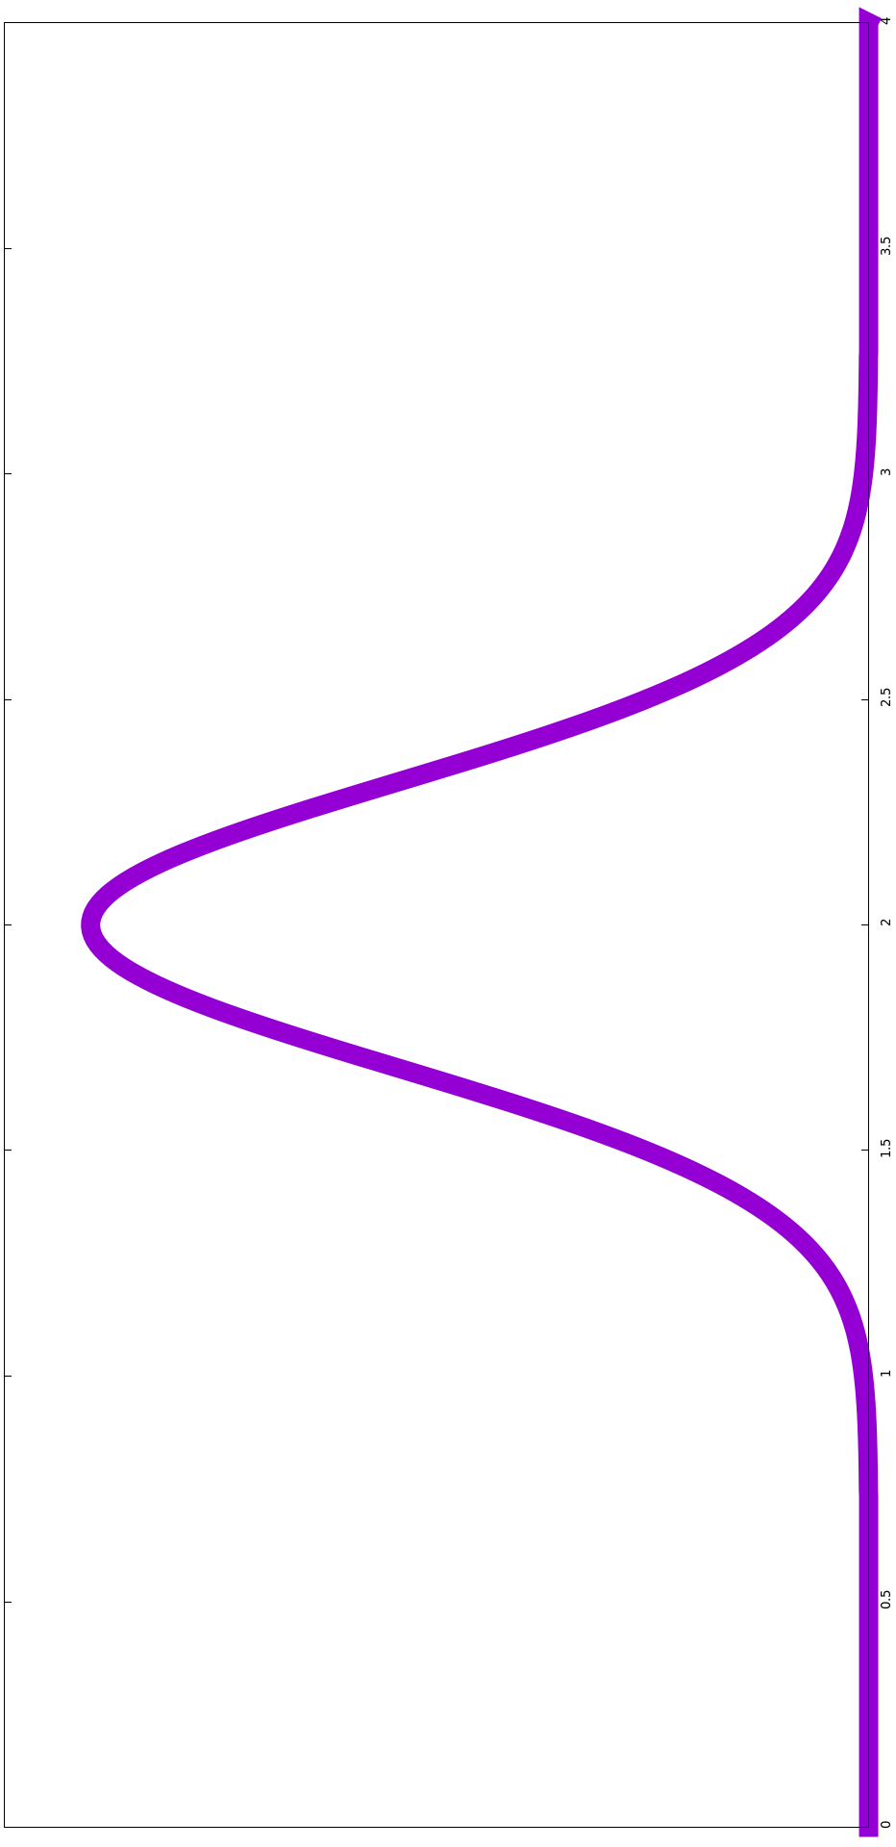
GOMEA for brachytherapy
Figure out dependencies between variables
Estimate and sample from Gaussian distributions
Univariately
LCI LSI
0.03 0.53 0.98 1.32 …………………………………. 0.99 1.63 1.98 2.02 0.91 1.21
0.41 0.71 0.18 0.98 …………………………………. 1.05 0.83 2.51 1.14 1.31 0.01
0.18 0.21 1.31 0.54 …………………………………. 3.14 2.21 0.91 1.31 1.41 -0.51
0.62 0.99 0.43 1.42 …………………………………. 1.31 1.03 1.33 1.02 1.11 1.31
1.33 0.21 1.90 0.88 …………………………………. 1.54 0.94 0.91 1.11 0.55 2.01
………………………………….…………………………………………………………………………. .……. ……..

Slide 122
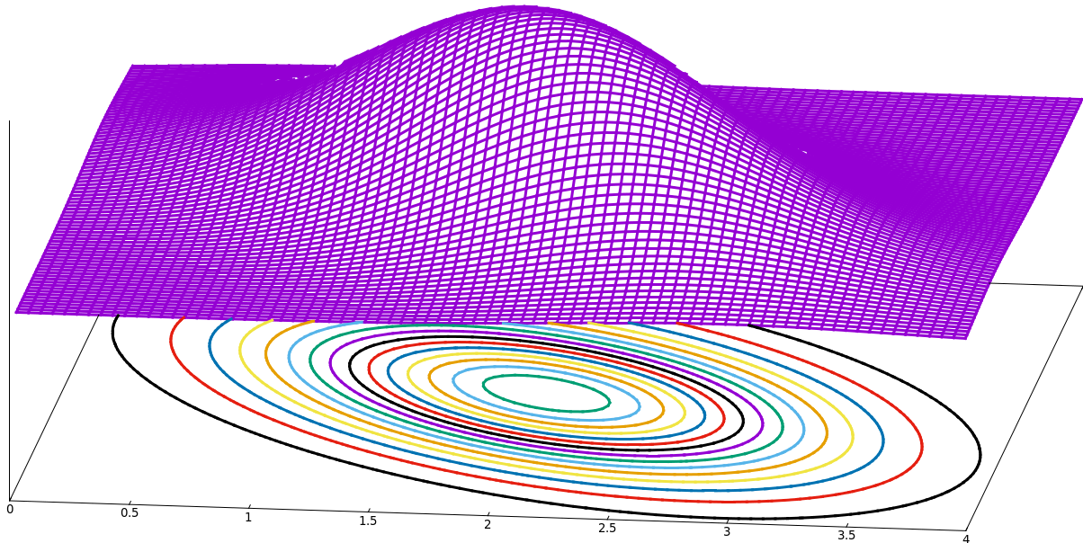
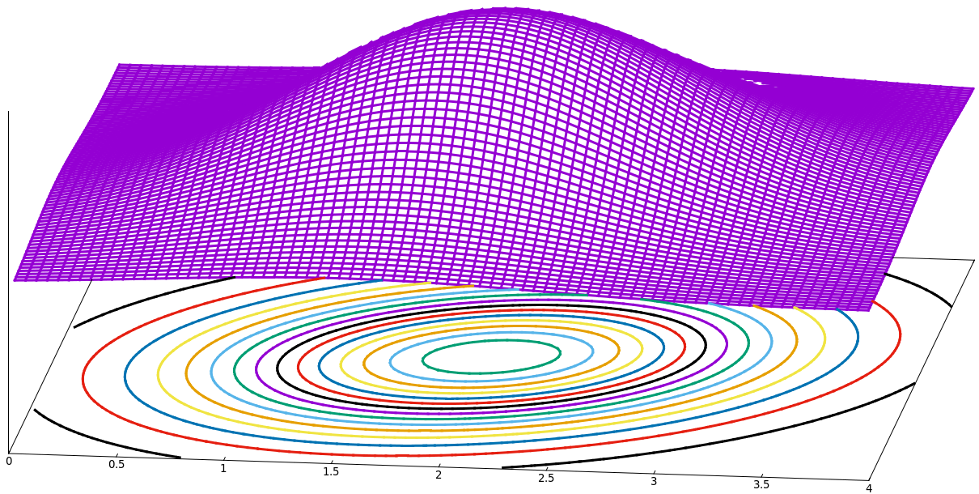
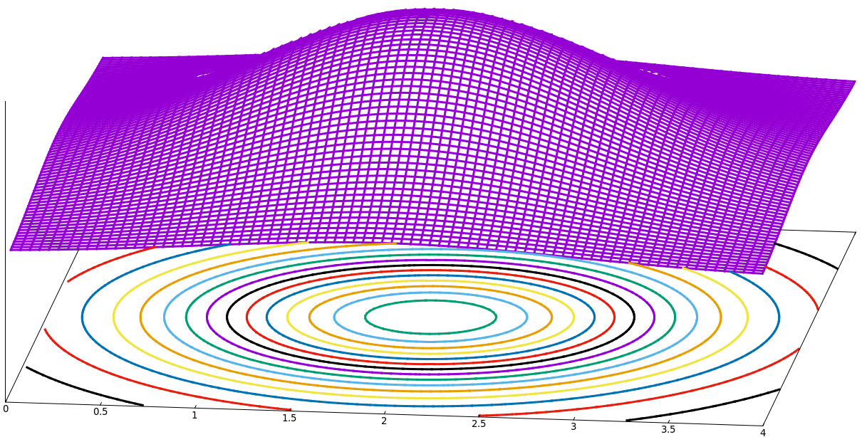
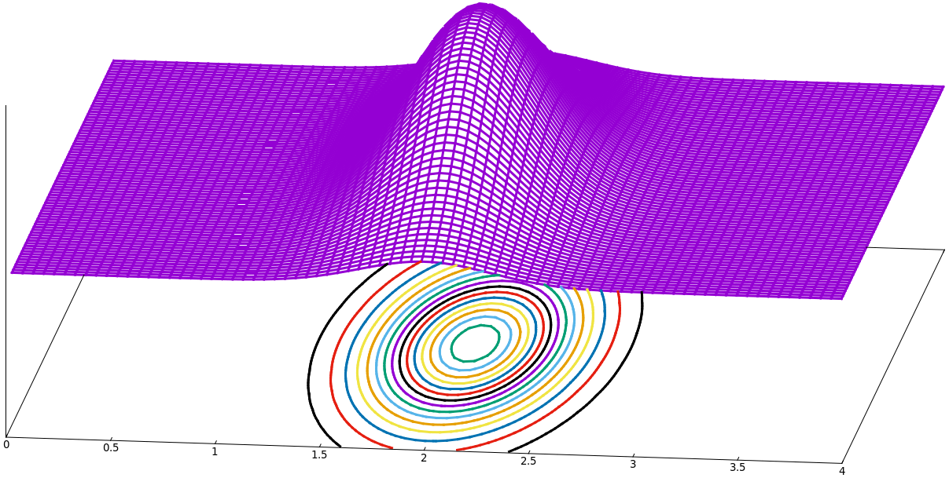
GOMEA for brachytherapy
Figure out dependencies between variables
Estimate and sample from Gaussian distributions
Univariately
Bivariately
LCI LSI
0.03 0.53 0.98 1.32 …………………………………. 0.99 1.63 1.98 2.02 0.91 1.21
0.41 0.71 0.18 0.98 …………………………………. 1.05 0.83 2.51 1.14 1.31 0.01
0.18 0.21 1.31 0.54 …………………………………. 3.14 2.21 0.91 1.31 1.41 -0.51
0.62 0.99 0.43 1.42 …………………………………. 1.31 1.03 1.33 1.02 1.11 1.31
1.33 0.21 1.90 0.88 …………………………………. 1.54 0.94 0.91 1.11 0.55 2.01
………………………………….…………………………………………………………………………. .……. ……..

Slide 123
GOMEA for brachytherapy
Figure out dependencies between variables
Estimate and sample from Gaussian distributions
Univariately
Bivariately
Multivariately
LCI LSI
0.03 0.53 0.98 1.32 …………………………………. 0.99 1.63 1.98 2.02 0.91 1.21
0.41 0.71 0.18 0.98 …………………………………. 1.05 0.83 2.51 1.14 1.31 0.01
0.18 0.21 1.31 0.54 …………………………………. 3.14 2.21 0.91 1.31 1.41 -0.51
0.62 0.99 0.43 1.42 …………………………………. 1.31 1.03 1.33 1.02 1.11 1.31
1.33 0.21 1.90 0.88 …………………………………. 1.54 0.94 0.91 1.11 0.55 2.01
………………………………….…………………………………………………………………………. .……. ……..

Slide 124
GOMEA for Brachytherapy
Better & faster than other state-of-the-art EAs
(Luong et al., Swarm and Evolutionary .Computation, 2017)
GPU speedup: from +/- 60 mins. to +/- 30 secs.
(Bouter et al., in preparation)
What about clinical quality?

Slide 125
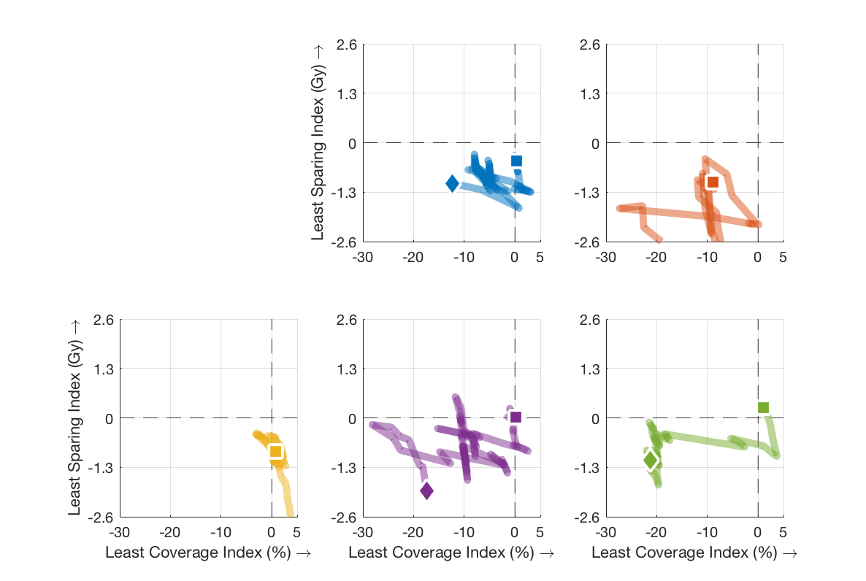
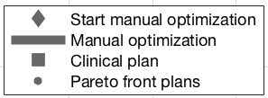
Evolutionary Intelligence in RT
GOMEA plans

Slide 126
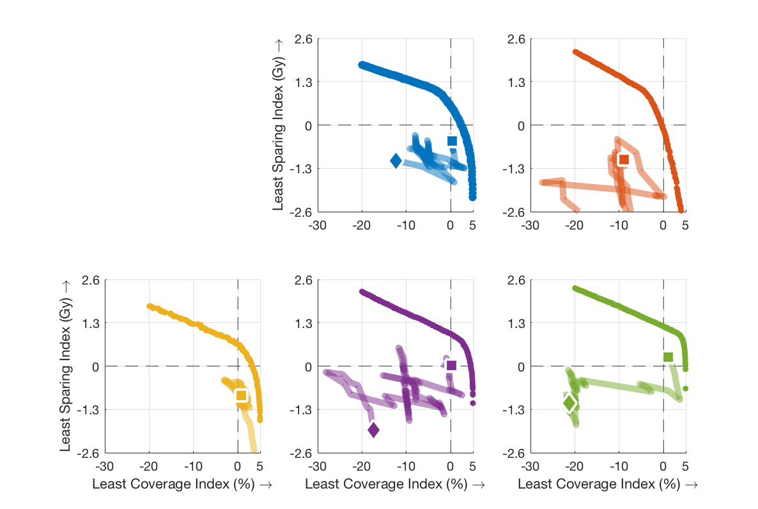
Evolutionary Intelligence in RT
GOMEA plans

Slide 127
GOMEA for brachytherapy
Blinded observer study at AMC: how often is a GOMEA outcome a preferred treatment plan?
?

Slide 128
GOMEA for brachytherapy
Blinded observer study at AMC: how often is a GOMEA outcome a preferred treatment plan?
> 98%

Slide 129
GOMEA for brachytherapy - extensions
Non-linear,.non-smooth, non-convex objectives
Optimize directly with MO-RV-GOMEA (GPU)
Yellow area is where all clinical aims are surpassed
REAL TIME
10x SPEED

Slide 130
GOMEA for brachytherapy
Working on various extensions

Slide 131
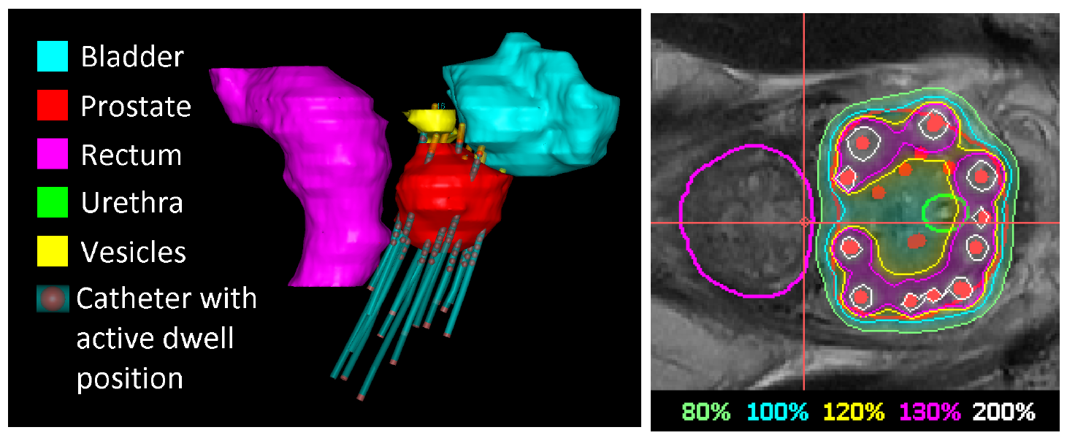
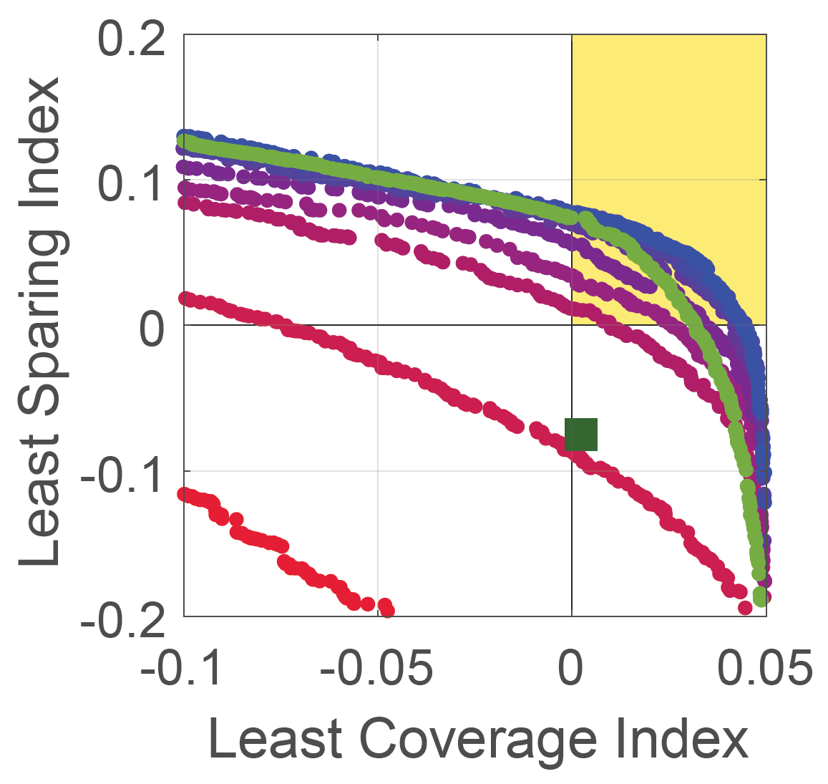
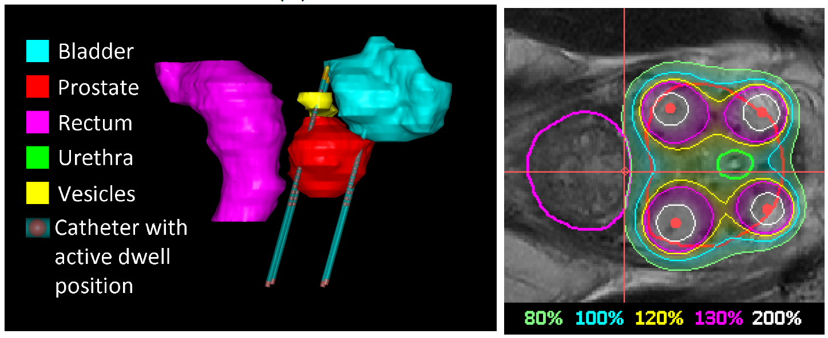
GOMEA for brachytherapy
Working on various extensions
Including catheter configuration optimization
(Sadowski et al., Proc. GECCO, 2017)
(van der Meer et al., Proc. GECCO, 2018)

Slide 132
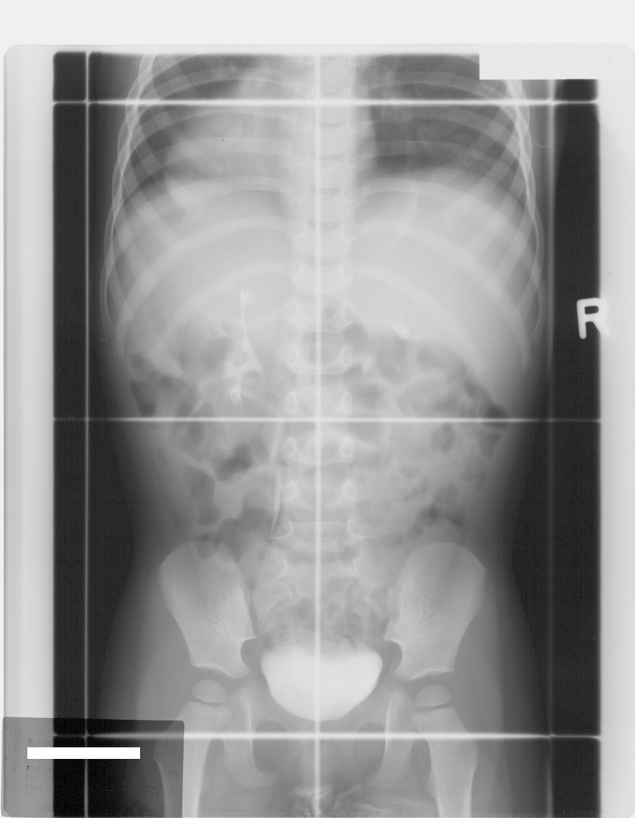
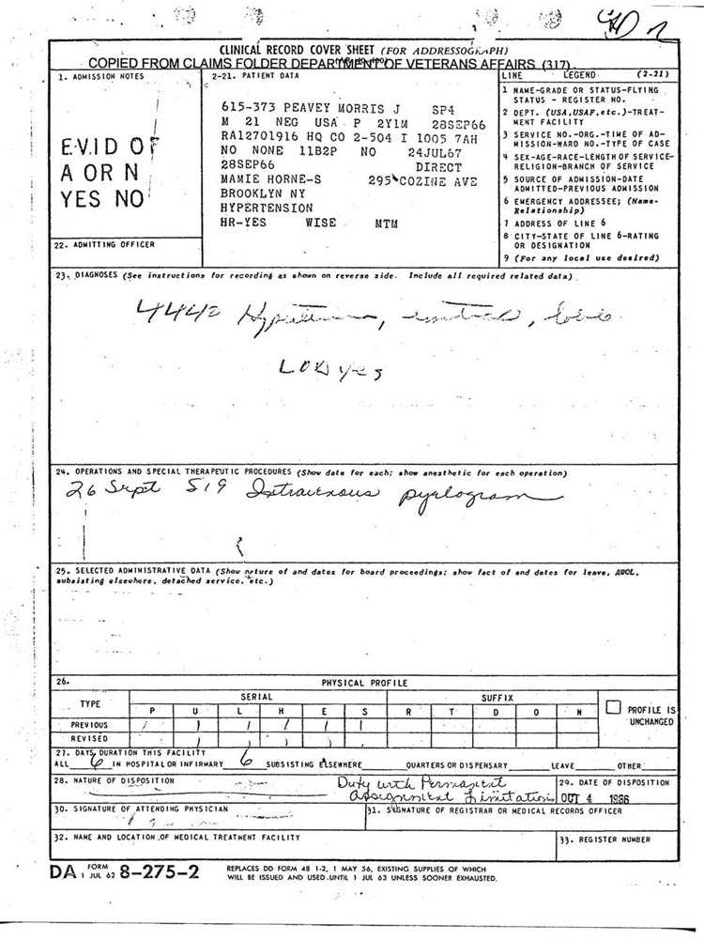
Evolutionary Intelligence in Medicine
Mean liver dose: 8 Gy
Mean spleen dose: 6 Gy
Mean heart dose: 4 Gy
…
Relationship Dose - Late Adverse Effects

Slide 133
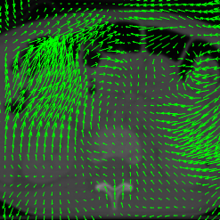
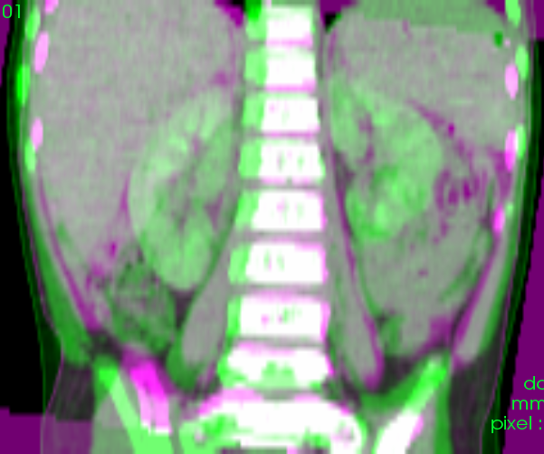
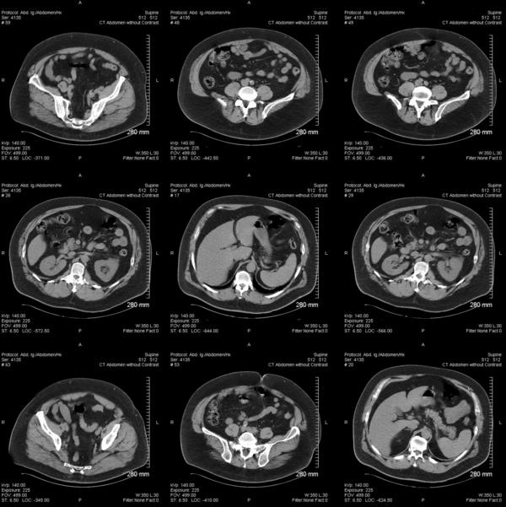
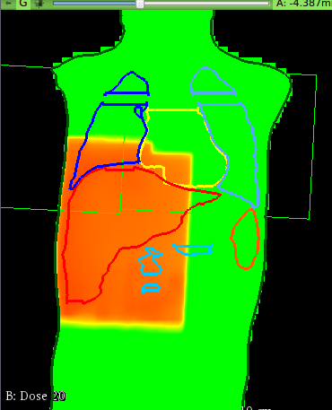
Evolutionary Intelligence in Medicine
historically treated patient
adaptation step (deformable image registration)
Machine Learning similarity matcher
recent patient data (CTs)
treatment simulation

Slide 134
GOMEA for explainable AI
Machine-learn similarity

Slide 135
GOMEA for explainable AI
Machine-learn similarity
Possible to learn (random forests)
overall body similarity
organ location
(M. Virgolin et al., Medical Physics, 2018)

Slide 136
GOMEA for explainable AI
Machine-learn similarity
Possible to learn (random forests)
overall body similarity
organ location
(M. Virgolin et al., Medical Physics, 2018)
Difficult to interpret learned model

Slide 137
GOMEA for explainable AI
Use GOMEA-based Genetic Programming to
enhance features with non-linear combinations,
and/or directly learn similarity function

Slide 138
GOMEA for explainable AI
Use GOMEA-based Genetic Programming to
enhance features with non-linear combinations,
and/or directly learn similarity function
Get more insight into features / relation
(M. Virgolin et al., Proc. GECCO, 2018)
More powerful than standard GP when looking for .small, interpretable features

Slide 139
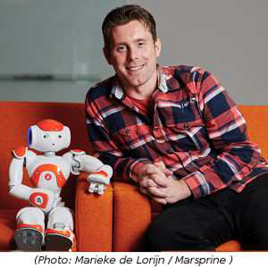
GOMEA for robot buddies
Robot buddies for childhood
cancer patients
Reduce stress, improve
quality of life

Slide 140
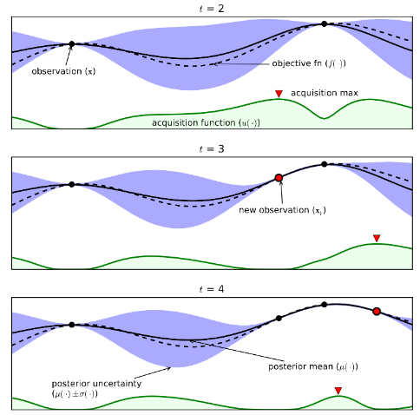
GOMEA for robot buddies
Robot buddies for childhood
cancer patients
Reduce stress, improve
quality of life
Use/advance EML for emotion recognition
Deep-Learning-hyperparameter
optimization (Bayesian
optimization – GOMEA combo)
(Rincon and Bosman, in preparation)
(Image from Shariari et al, 2016)

Slide 141
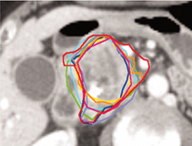
GOMEA for Medical Image Segmentation
FEDMix: Fusible Evolutionary Deep Neural Network
.Mixture Learning from Distributed Data for Robust
.Medical Image Analysis (started September 2018)
Integrates evolutionary algorithms and deep learning

Slide 142
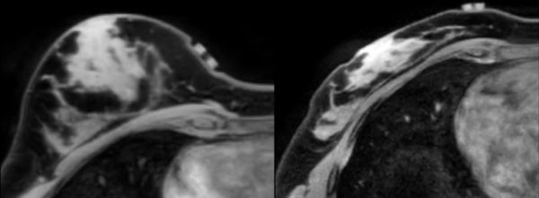
GOMEA for Medical Image Registration
Deform medical image to look like another image

Slide 143
GOMEA for Medical Image Registration
MODIR: Multi-Objective Deformable Image .Registration (to start January 2019)
Multi-objective Evolutionary algorithms,
Biomechanical Modeling,
Deep Learning
User-friendly software design

Slide 144
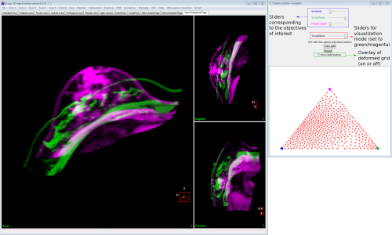
GOMEA for Medical Image Registration
Final solution selection insightful & easy
(Pirpinia et al., Journal of Medical Imaging)

Slide 145
Conclusions
GOMEA is a versatile, state-of-the-art, family of +(linkage-)model-based evolutionary algorithms

Slide 146
Conclusions
GOMEA is a versatile, state-of-the-art, family of +(linkage-)model-based evolutionary algorithms
GOMEA family is expanding rapidly

Slide 147
Conclusions
GOMEA is a versatile, state-of-the-art, family of +(linkage-)model-based evolutionary algorithms
GOMEA family is expanding rapidly
Binary, Integer, Permutation, Real-Valued, Mixed-Integer, +GP, SO, MO, …

Slide 148
Conclusions
GOMEA is a versatile, state-of-the-art, family of +(linkage-)model-based evolutionary algorithms
GOMEA family is expanding rapidly
Binary, Integer, Permutation, Real-Valued, Mixed-Integer, +GP, SO, MO, …
Also used in / tailored to real world

Slide 149
Conclusions
GOMEA is a versatile, state-of-the-art, family of +(linkage-)model-based evolutionary algorithms
GOMEA family is expanding rapidly
Binary, Integer, Permutation, Real-Valued, Mixed-Integer, +GP, SO, MO, …
Also used in / tailored to real world
Real real-world applications in medicine

Slide 150
Conclusions
GOMEA is a versatile, state-of-the-art, family of +(linkage-)model-based evolutionary algorithms
GOMEA family is expanding rapidly
Binary, Integer, Permutation, Real-Valued, Mixed-Integer, +GP, SO, MO, …
Also used in / tailored to real world
Real real-world applications in medicine
Real-world flavored uses in energy (not shown today)

Slide 151
Source Code & Vacancies
Various source code is freely available online!
Download, play, publish, cite, and let us know!
http://homepages.cwi.nl/~bosman

Slide 152
Thanks
PhD Students & Postdocs
Kelly van Bindsbergen, Anton Bouter, Arkadiy Dushatskiy, Hoang Luong, Stef Maree, Marjolein van der Meer, Kalia Orphanou, Kleopatra Pirpinia, Alejandro Rincon, Krzysztof Sadowski, Marco Virgolin, Ziyuan Wang
Senior Researchers
Tanja Alderliesten, Arjan Bel, Irma van Dijk, Marcel van Herk, Koen Hindriks, Martha Grootenhuis, Hans Merks, Mark Neerincx, Cécile Ronckers, Jan-Jakob Sonke, Dirk Thierens, Cees Witteveen
Support-, Industry-, Consultant-, Medical Staff
Brian Balgobind, Danique Barten, Karel Hinnen, Rob van der Laarse, Claudette Loo, Yury Niatsetski, Kees Koedooder, Christiaan Meijer, Adriënne Mendrik, Rob van Os, Bradley Pieters, Coen Rasch, Joost Schillings, Astrid Scholten, Bob van Veelen, Henrike Westerveld, Niek van Wieringen, Jan Wiersma, Gonneke Winter-Warnars
Academic Institute Partners
Amsterdam UMC, Delft University of Technology, NKI, PMC, Utrecht University

