Slide 1
Non-standard challenges in experimental optimization
Dr. Richard Allmendinger
Lecturer in Decision Sciences, School Business Engagement Lead
Alliance Manchester Business School, The University of Manchester
richard.allmendinger@manchester.ac.uk

Slide 2
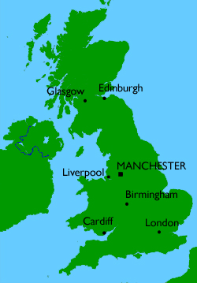
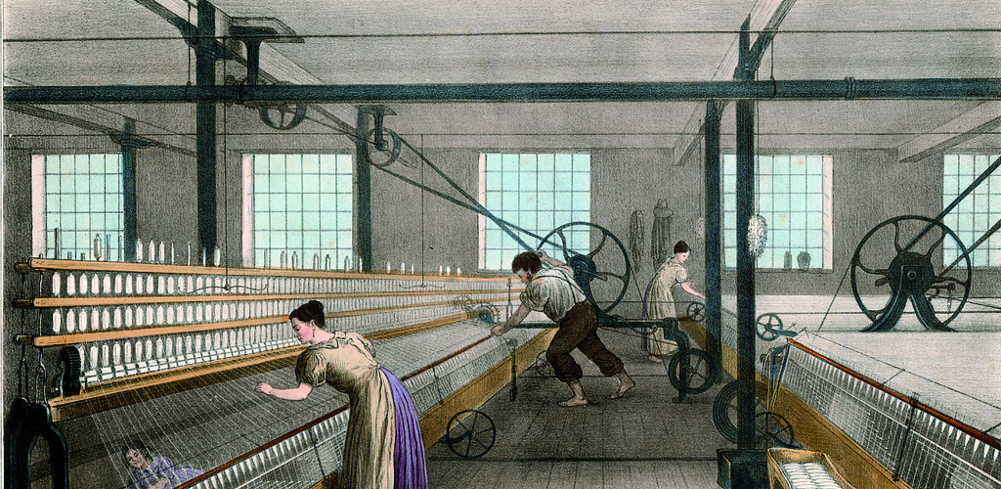
Manchester
2nd largest city in the UK
World's first industrial city (Cottonopolis)
Football capital
Music scene

Slide 3
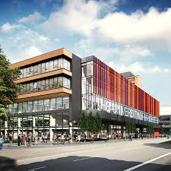
University of Manchester / AMBS
Largest single-site university 40,490 students and 3,849 staff
29th in the world, 6th in the UK
Largest & oldest UK business school >6,500 students globally, >500 staff
Ranked 2nd in the UK for research power

Slide 4
Who am I?
Name: Richard Allmendinger
Position: Lecturer in Decision Sciences, AMBS
Education:
Diplom (BSc + MSc) in Industrial Engineering
Research visit
PhD in Computer Science (with J. Knowles)
Postdoc in Biopharmaceutical Development

Slide 5
Who am I?
Other roles at UoM:
School Business Engagement Lead
Business Pathway Lead for the MSc in Data Science
AMBS Lead for the CDT in Data Analytics & Society
Teaching:
Programming in Python for Business Analytics (PGT)
Understanding Data and their Environment (PGT + PGR)

Slide 6
Who am I?
External roles:
Editorial Board Member of Applied Soft Computing (IF > 4)
Numerous conference chair roles (e.g. Workshop Chair – GECCO 2019, Technical Chair – IEEE CIBCB 2019, General Chair – IEEE CIBCB 2017)
Invited to Dagstuhl Seminars on EMO + MCDM since 2012
Delivered 1-week module on Data-Driven Optimization at the 27th Jyvaskyla Summer School
Founder and current Vice-Chair of IEEE Task Force on Optimization methods in Bioinformatics and Bioengineering

Slide 7
Who am I?
Research interests: Simulation, optimization and machine learning in
Healthcare
Music
Sports
Digital Advertising
Forensics
Experimental problems
Problem features: Multiple/many objectives, constraints, uncertainties, expensive evaluations, user preferences, dynamic changes

Slide 8
Who am I?
Research interests: Simulation, optimization and machine learning in
Healthcare
Music
Sports
Digital Advertising
Forensics
Experimental problems
Problem features: Multiple/many objectives, constraints, uncertainties, expensive evaluations, user preferences, dynamic changes

Slide 9
And off work...

Slide 10
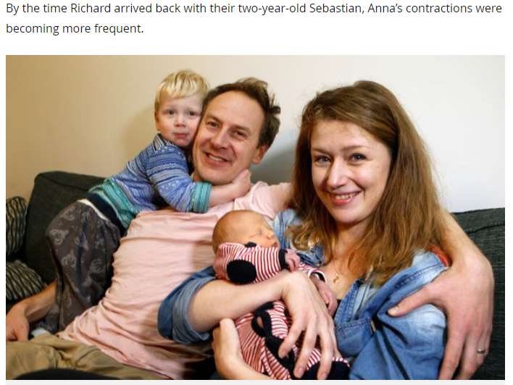
Fun fact
My (second) son is the first child ever born in an Uber in the UK

Slide 11
Agenda
Overview of active research projects
Experimental optimization (EO)
What is EO?
Some application domains
Some challenges of EO in biology and medicine
Change of variables during search
Objectives with different evaluation times
Handling ephemeral resource constraints
What is next?

Slide 12
Agenda
Overview of active research projects
Experimental optimization (EO)
What is EO?
Some application domains
Some challenges of EO in biology and medicine
Change of variables during search
Objectives with different evaluation times
Handling ephemeral resource constraints
What is next?

Slide 13
Active research projects
PhD projects
Multiobjective clustering for streaming data
Football analytics (Wyscout)
Exploration vs exploitation in job seeking
Grouping of burns injury patients (MDSAS, NHS)
Combining bio-feedback and machine learning for teaching high-level musical performance
An explainable AI platform for forensic testing (FTS)
Machine decision makers
Data-driven optimization for personalized medicine (Biopharm Services) – to start in September (application deadline 29th of March, apply if interested)

Slide 14
Further active research projects
Knowledge Transfer Partnership (KTP)
8. Extending an existing simulation software for drug manufacturing processes with a flexible optimization tool (Biopharm Services)
9. Analytics platform for a childcare provider (Childcare Connect) – proposal under review
Non-funded research
10. Tunable problem instance generator for multi and many-objetive optimization (Jonathan Fieldsend, Kaisa Miettinen)
11. Experimental optimization (Joshua Knowles, Jonathan Fieldsend, Kaisa Miettinen)

Slide 15
Agenda
Overview of active research projects
Experimental optimization (EO)
What is EO?
Some application domains
Some challenges of EO in biology and medicine
Change of variables during search
Objectives with different evaluation times
Handling ephemeral resource constraints
What is next?

Slide 16
Experimental optimization
Experimental optimization problems: Objective function(s) are not available in closed form but are replaced with real physical/chemical/biological experiments or computer simulation(s)
Working example: Discovery of potent drugs
“Typical” Characteristics
Experiments are time-consuming
Experiments are expensive
Only few experiments are possible
There are exceptions as well!

Slide 17
Further challenges
Noise and uncertainty of measurements
Multiple objectives
Dynamically changing requirements of experimentalists/stakeholders!
Dynamically changing (resource) constraints
Cost choices during optimization → Some experiments may cost more than others
Unusual constraints on population sizes and other hyperparameters

Slide 18
Example applications
Examples:
Flow Plate
Bended Pipe
Nozzle
Nutrient Solutions
Coffee Formulations
Quantum Control
Biological Experiments
1960s … … … 2000s

Slide 19
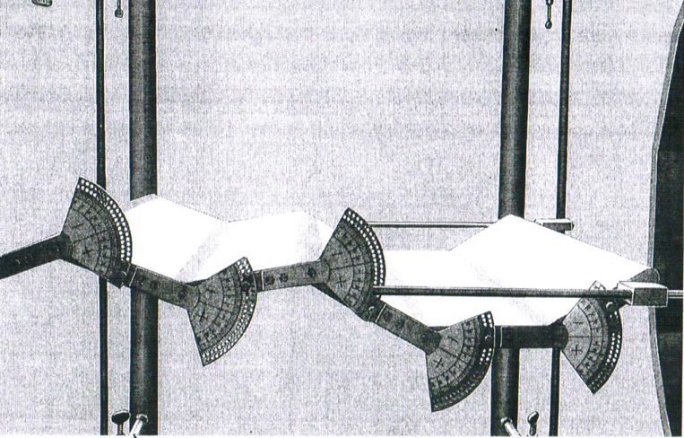
Early Experiments I: Flow Plate
A plate with 5 controllable angle brackets
Measurable air flow drag (by a pitot tube)‏
Figure from: I. Rechenberg, Evolutionsstrategie ´73, frommann-holzboog, Stuttgart 1973

Slide 20
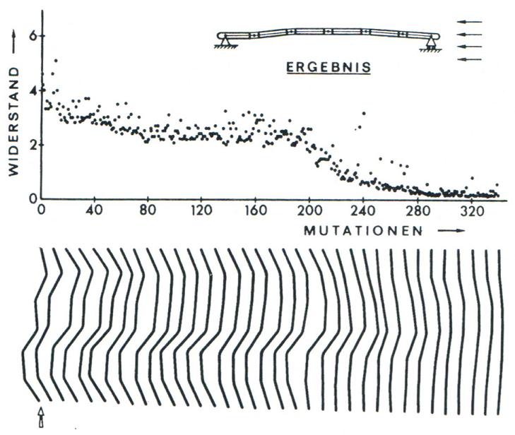
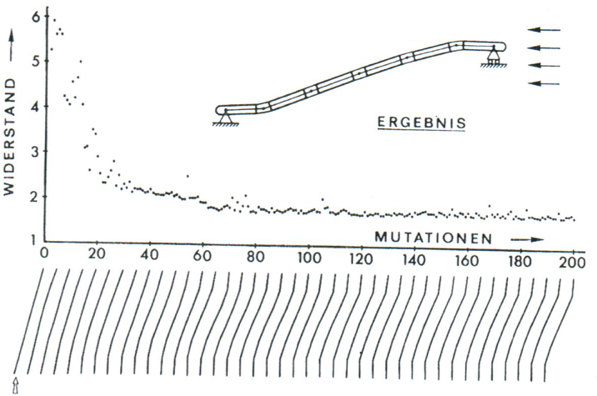
Early Experiments I: Flow Plate
Experiment 1:
Left / right supporting point at same
y-coordinate.
Horizontal flow.
Minimize drag.
Experiment 2:
Left supporting point 25% lower than
right one.
Horizontal flow.
Minimize drag.
Plate drag
Number of mutations and selected plate shapes
Number of mutations and selected plate shapes
Start
-30
-40
40
-30
40
Start
0
0
0
0
0
End
0
4
0
6
-6
End
16
6
2
0
-18
Figures from: I. Rechenberg, Evolutionsstrategie ´73, frommann-holzboog, Stuttgart 1973

Slide 21
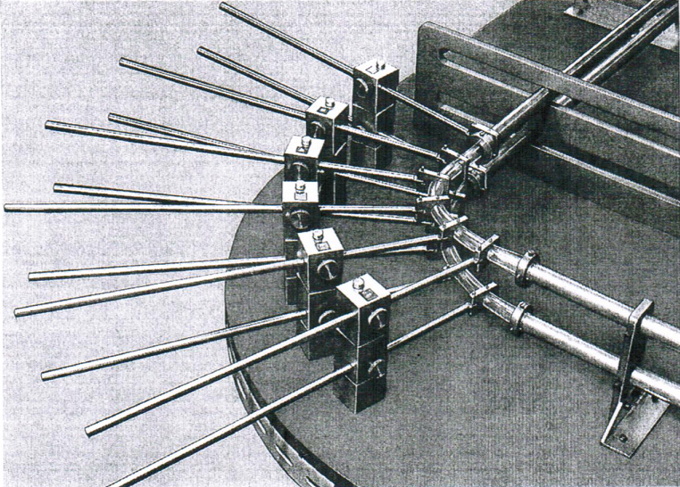
Early Experiments II: Bended Pipe
A flexible pipe with 6 controllable bending devices
Minimize bend losses of liquid flow
Measure drag by pitot tube
Figure from: I. Rechenberg, Evolutionsstrategie ´73, frommann-holzboog, Stuttgart 1973

Slide 22
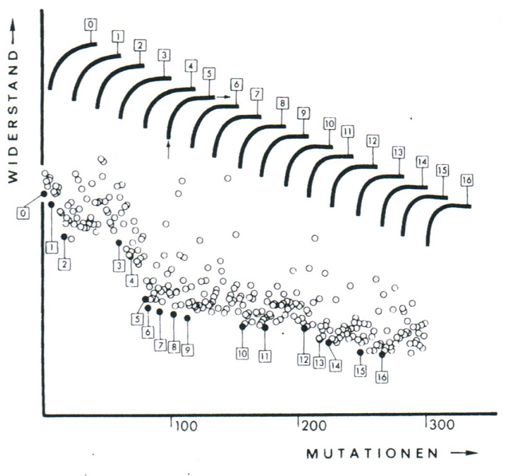
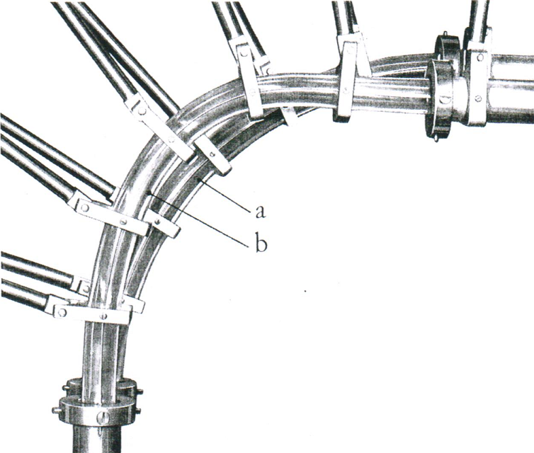
Early Experiments II: Bended Pipe
Pipe drag
Number of mutations and selected pipe shapes
Initial (a) and optimized (b) pipe shape
Bend loss of final form reduced by 10%
Including drag a total reduction of 2%
Figure from: I. Rechenberg, Evolutionsstrategie ´73, frommann-holzboog, Stuttgart 1973

Slide 23
Early Experiments III: Nozzle
What can be done if physics, (bio-) chemistry, … of process unkown?
No model or simulation program available!
Idea: Optimize with the real object
“Hardware in the loop”
Example: Supersonic nozzle, turbulent flow, physical model not available.

Slide 24
Early Experiments III: Nozzle
Production of differently formed conic nozzle parts (pierced plates).
Form of nozzle part is value of decision variable.
choosing conic nozzle parts (by EA) clamping of conic nozzle parts (manually) steam under high pressure passed into nozzle degree of efficiency is measured!
„simulator
replacement“

Slide 25
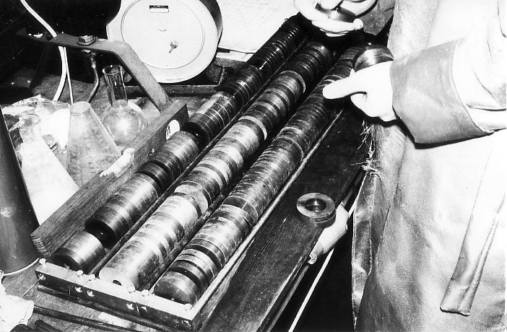
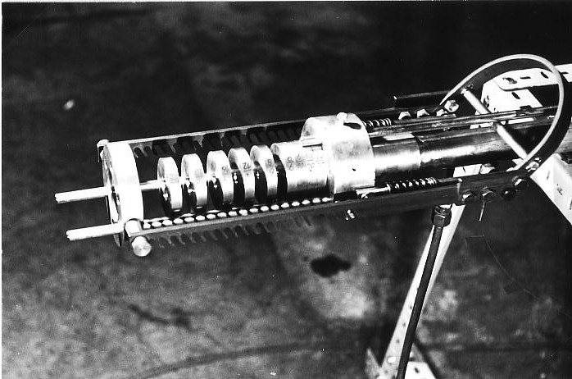
Early Experiments III: Nozzle
collection of conical nozzle parts
device for clamping nozzle parts
Figures courtesy of Hans-Paul Schwefel

Slide 26
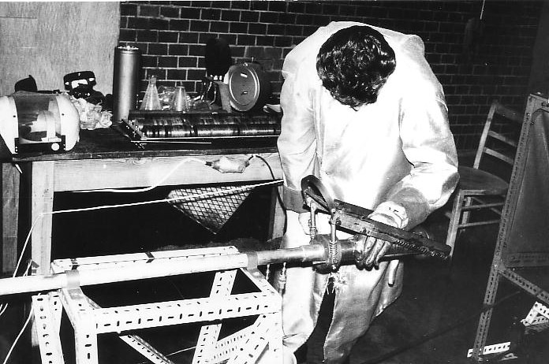
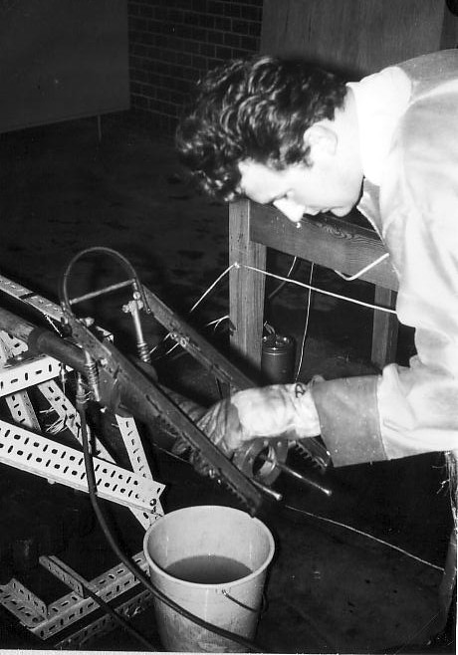
Early Experiments III: Nozzle
Hans-Paul Schwefel while changing nozzle parts
Figures courtesy of Hans-Paul Schwefel

Slide 27
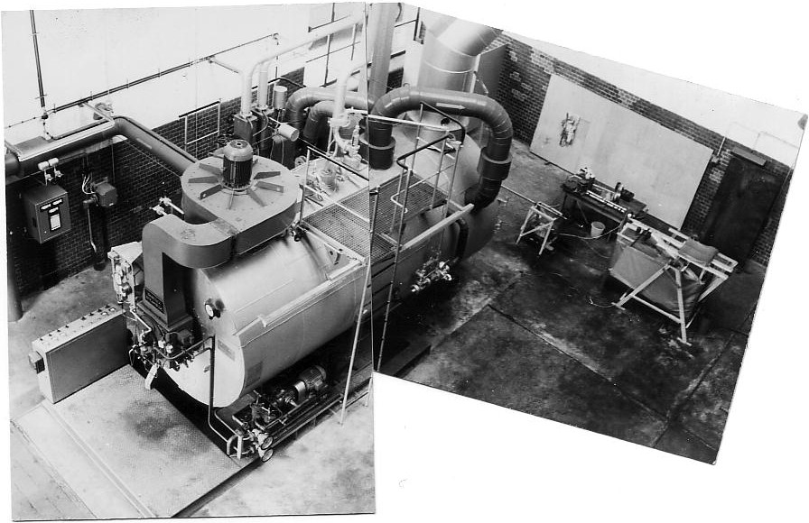
Early Experiments III: Nozzle
steam plant / experimental setup
Figures courtesy of Hans-Paul Schwefel

Slide 28
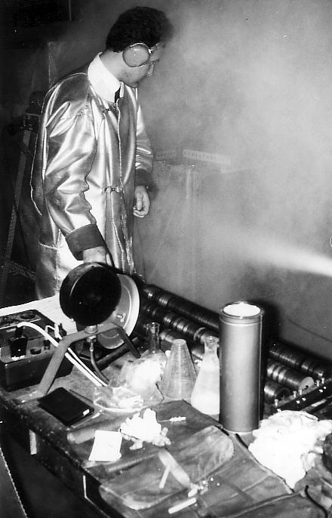
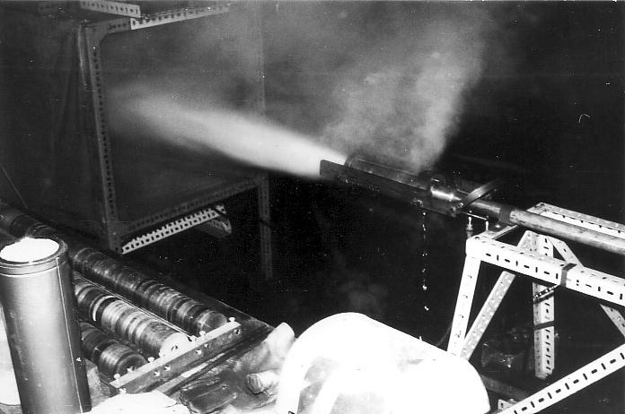
Early Experiments III: Nozzle
the nozzle in operation …
… while measuring degree of efficiency
Figures courtesy of Hans-Paul Schwefel

Slide 29
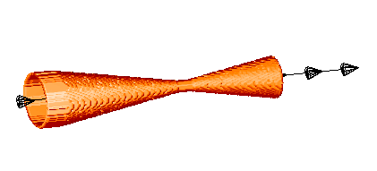
Early Experiments III: Nozzle
Illustrative Example: Optimize Efficiency
Initial:
Evolution:
32% Improvement in Efficiency !
Notes:
29

Slide 30
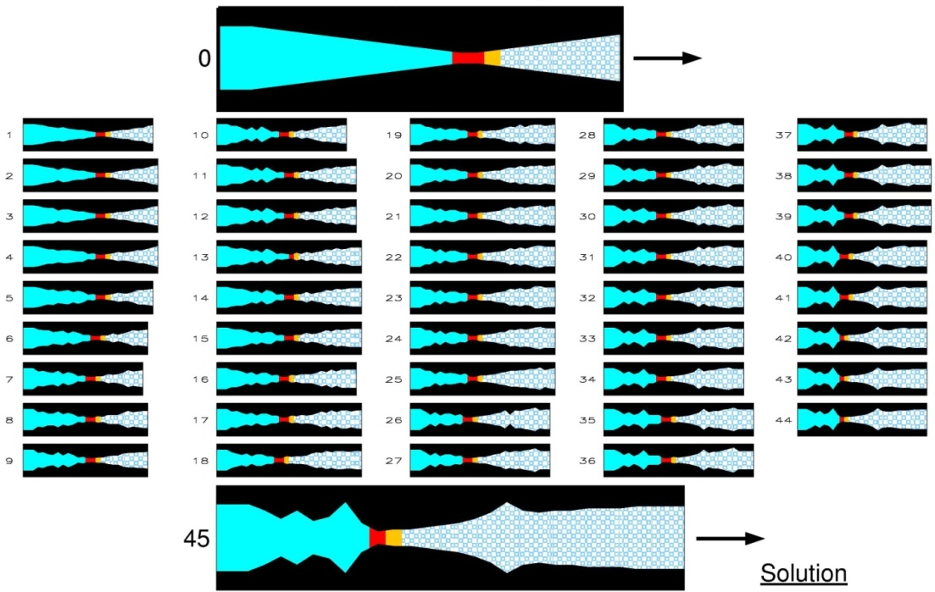
Early Experiments III: Nozzle
250 experiments were made.
45 improvements found.
J. Klockgether and H.-P. Schwefel, “Two-phase nozzle and hollow core jet experiments,” in Proceedings of the 11th Symposium on Engineering Aspects of Magneto-Hydrodynamics, Caltech, Pasadena, California, USA, 1970.

Slide 31
Experimental optimization: Fundamentals
Speed: fast convergence is required
Practical solutions: “greedy” variants of evolutionary algorithms, e.g., derandomized evolution strategies or surrogate-assisted optimization
Reliability: reproducibility of results within a margin
Environmental parameters often hidden (temperature, pressure, …)
Scenarios of recording experimental outliers must be avoided (elitism is tricky…)
Possible solutions: employing comma (non-elitist) strategies or increasing sampling rate of measurements (“signal averaging”)
Robustness: manufacturing feasibility
Reference solution (recommended):
pre-designed reference item, robust and stable, having a known objective function value
J. Klockgether and H.-P. Schwefel, “Two-phase nozzle and hollow core jet experiments,” in Proceedings of the 11th Symposium on Engineering Aspects of Magneto-Hydrodynamics, Caltech, Pasadena, California, USA, 1970.

Slide 32
Potential application areas
Quantum control
large (more than thousand)
CLADE
Crop-Breeding
Number of experiments
Instrument setup optimization
Drug discovery
Bended pipe
Flow plate
small (max a few 100)
Chromatography
Nozzle
Coffee
Chocolate
Material design optimization
subjective
numerical
Selection/evaluation

Slide 33
Potential application areas
Cosmetics / Detergent Formulation Optimization
Catalyst Formulation Optimization (Cost, Effectiveness, …)‏
Subjective Evaluation Applications based on Human Taste or other Senses
Engineering Applications Requiring Real-World Experiments for Measurement
Concrete Formulation Optimization
Glue Formulation Optimization
Plant Startup Process
Chemical Compound Synthesis Processes (e.g., Drugs)‏
Instrument Setup Optimization

Slide 34
Agenda
Overview of active research projects
Experimental optimization (EO)
What is EO?
Some application domains
Some challenges of EO in biology and medicine
Change of variables during search
Objectives with different evaluation times
Handling ephemeral resource constraints
What is next?

Slide 35
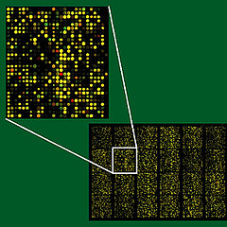
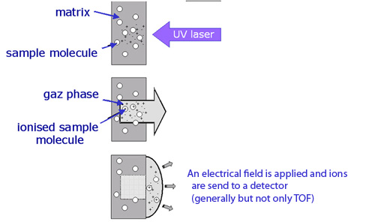
Experimental optimization in biology and medicine
Evolution of real DNA on microarray chips
Dealing with a very large population size
Landscape analysis / optimizing evolution
Drug discovery and medical microchipping
Change of variables during search
Objectives with different evaluation times
Lethal environments
Optimizing the design of analytical equipment
Handling ephemeral resource constraints
Notes:
The second problem is an issue that Joshua has encountered in his work with the biologists on designing analytical equipment. He did not know the answer to this issue and so decided to make a PhD project around it. I have taken on that project, which was back in 2009 and have kept working on this topic since then. The issue is around what we are calling “ephemeral resource constraints” and we have done on work on how these arise in experimental problems, and what we can do about them.

Slide 36
Experimental optimization in biology and medicine
Evolution of real DNA on microarray chips
Dealing with a very large population size
Landscape analysis / optimizing evolution
Drug discovery and medical microchipping
Change of variables during search
Objectives with different evaluation times
Lethal environments
Optimizing the design of analytical equipment
Handling ephemeral resource constraints
Notes:
The second problem is an issue that Joshua has encountered in his work with the biologists on designing analytical equipment. He did not know the answer to this issue and so decided to make a PhD project around it. I have taken on that project, which was back in 2009 and have kept working on this topic since then. The issue is around what we are calling “ephemeral resource constraints” and we have done on work on how these arise in experimental problems, and what we can do about them.

Slide 37
Change of variables during search
Real problem: Identify most effective drug cocktails from a non-stationary drug library
Properties:
Time at which problem is changing is known in advance (and can potentially be influenced)
Search space is being modified (which induces a modification in the fitness landscape) instead of modifying the objective function(s) directly
Challenge: How to use the knowledge gathered so far to explore the new search space efficiently

Slide 38
Change of variables during search
Real problem: Identify most effective drug cocktails from a non-stationary drug library
Illustration of what is happening
(a,b,c,d,e) fitness
(0,0,0,1,0) 1
(1,1,0,0,0) 0.5
(0,1,0,1,1) 0.8
(1,0,1,1,1) 0.7
Cocktails with new drugs
X_{g}
Cocktails not using replaced drugs
X₀
Cocktails using replaced drugs

Slide 39
Change of variables during search
Real problem: Identify most effective drug cocktails from a non-stationary drug library
Fair mutation (FM): Perform usual optimization alongside rapid exploration of the space of solutions using any of the new variables
Cocktails with new drugs
X_{g}
Cocktails not using replaced drugs
X₀
Cocktails using replaced drugs

Slide 40
Change of variables during search
Real problem: Identify most effective drug cocktails from a non-stationary drug library
Fair mutation (FM): Perform usual optimization alongside rapid exploration of the space of solutions using any of the new variables
Fair because … we test each new variable within the same number of offspring solutions
Mutation because .... we apply a raised mutation rate for a certain number of generations to all offspring solutions with a 1-bit at any of the new variables

Slide 41
Fair mutation
2 new variables → dedicate 4/2 offspring to each new variable, i.e. set the values of the new variables to 1
Upon variable change
(a,b,c,d,e)
(0,0,0,1,0)
(1,1,0,0,0)
(0,1,0,1,1)
(1,0,1,1,1)
(0,1,1,1,0)
(1,0,0,1,1)
(0,0,0,1,1)
(1,1,1,0,0)
(0,1,1,1,0)
(1,0,1,1,1)
(0,0,0,1,1)
(1,1,1,0,1)
Generate offspring as usual; then mutate each offpsring with raised mutation rate
Set value of first new variable to 1 for first two offspring, and value of second new variable to 1 for next two offspring
Next couple of generations
(0,1,1,1,1)
(1,0,1,1,0)
(0,1,0,1,0)
(1,1,0,0,0)
(1,0,1,0,1)
(1,1,1,0,0)
(0,1,0,1,0)
(1,1,0,0,0)
Generate offspring population as usual but any offspring containing a 1-bit at a any of the new variables mutate other bits using raised mutation rate

Slide 42
Change of variables during search
Experimental study:
Investigate sensitivity of fair mutation to parameter settings
Fair mutation was compared against standard dynamic optimization techniques
restart optimization
re-evaluate only
niching
triggered hypermutation
Existing test problems (NK landscapes) had to be adjusted
Graphs are difficult to read in slides so please refer to PPSN paper for them
R. Allmendinger and J. Knowles (2010): Evolutionary Optimization on Problems Subject to Changes of Variables. Parallel Problem Solving in Nature - PPSN XI , pp 151-160.
B.G. Small, B.W. McColl, R. Allmendinger, J. Pahle, G. Lopez-Castejon, N.J. Rothwell, J. Knowles, P. Mendes, D. Brough, and D.B. Kell (2011): Efficient discovery of anti-inflammatory small molecule combinations using evolutionary computing. Nature Chemical Biology, 7: 902-908.

Slide 43
Change of variables during search
Findings: Performance of strategies depends on
fitness landscape being search over → epistasis is critical
frequency and severity of changes
Some recommendations:
Only little additional diversity if at all needs to be introduced into the population when changing a few variables frequently or optimizing a landscape with a low degree of variable interactions → Use fair mutation or simply re-evaluate current population and carry on as usual
Restart optimization when changing many variables (around 10 or more out of 30), particularly on a quite epistatic fitness landscape

Slide 44
Change of variables during search
Possible extensions of this work
Better strategies (how to remove old variables/introduce new variables + how to adapt optimization upon a variable change)
Should different strategies be used depending on whether search space is expanded or reduced?
Real-valued search spaces
Bayesian methods applicable?
R. Allmendinger and J. Knowles (2010): Evolutionary Optimization on Problems Subject to Changes of Variables. Parallel Problem Solving in Nature - PPSN XI , pp 151-160.
B.G. Small, B.W. McColl, R. Allmendinger, J. Pahle, G. Lopez-Castejon, N.J. Rothwell, J. Knowles, P. Mendes, D. Brough, and D.B. Kell (2011): Efficient discovery of anti-inflammatory small molecule combinations using evolutionary computing. Nature Chemical Biology, 7: 902-908.

Slide 45
Experimental optimization in biology and medicine
Evolution of real DNA on microarray chips
Dealing with a very large population size
Landscape analysis / optimizing evolution
Drug discovery and medical microchipping
Change of variables during search
Objectives with different evaluation times
Lethal environments
Optimizing the design of analytical equipment
Handling ephemeral resource constraints
Notes:
The second problem is an issue that Joshua has encountered in his work with the biologists on designing analytical equipment. He did not know the answer to this issue and so decided to make a PhD project around it. I have taken on that project, which was back in 2009 and have kept working on this topic since then. The issue is around what we are calling “ephemeral resource constraints” and we have done on work on how these arise in experimental problems, and what we can do about them.

Slide 46
Objectives with different evaluation times
Multiobjective optimization problems where at least one of the objective functions requires a relatively longer time to be evaluated than the cheapest/quickest of the objective functions
E.g. identify most potent drug cocktails that is also most economical to manufacture
What if we have a limited budget and/or time frame?
VS
Cost of manufacture:
Quick and cheap to obtain via simulation
Potency of drug cocktails:
Laborious, time-consuming
and expensive to obtain
R. Allmendinger and J. Knowles (2013): 'Hang On a Minute': Investigations on the Effects of Delayed Objective Functions in Multiobjective Optimization. Evolutionary Multi-Criterion Optimization (EMO 2013), LNCS 7811, pp 6-20.
R. Allmendinger, J. Handl, and J. Knowles (2015): Multiobjective Optimization: When Objectives Exhibit Unequal Latencies. European Journal of Operations Research, 243(2): 497-513.

Slide 47
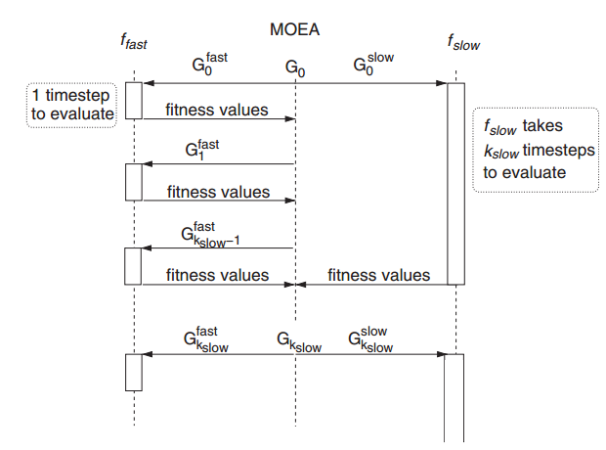
2 objectives, one fast and one slow objective
G₀ can be a population or a single solution
Standard approach is to wait until all objectives are evaluated before updating the population → Waiting
Issue: ?

Slide 48
2 objectives, one fast and one slow objective
G₀ can be a population or a single solution
Do single-objective with fast objective only, and then evaluate best solutions on slow objective at the very end. → Fast-first
Issue: ?

Slide 49
2 objectives, one fast and one slow objective
G₀ can be a population or a single solution
Evaluate both objectives as often as possible using an interleaving approach.
Do single-objective optimization on fast objective while initial population is evaluated on slow objective. Once slow objective has been evaluated, filter out most promising solutions evaluated on the fast objective only to decide which solutions to evaluate next on the slow objective. → Speculative interleaving
Issue: ?

Slide 50
2 objectives, one fast and one slow objective
G₀ can be a population or a single solution
Same as speculative interleaving but replace single-objective optimization with solutions generated by applying mutation to population evaluated on slow objective. → Brood interleaving
Issue: ?

Slide 51
Experimental study
All strategies augmented on IBEA
Binary test problems
Bi-objective OneMax problem adjusted to control correlation
Leading ones trailing zeros (max negative correlation)
Multiobjective NK landscapes
Kriging-assisted reference vector guided evolutionary algorithm(K-RVEA)
Real-valued test problems: DTLZ + UF
T. Chugh, R. Allmendinger, V. Ojalehto, K. Miettinen (2018): Surrogate-assisted Evolutionary Biobjective Optimization for Objectives with Non-uniform Latencies. Proceedings of the Annual Conference on Genetic and Evolutionary Computation (GECCO '18), pp 609-616.
R. Allmendinger and J. Knowles (2013): 'Hang On a Minute': Investigations on the Effects of Delayed Objective Functions in Multiobjective Optimization. Evolutionary Multi-Criterion Optimization (EMO 2013), LNCS 7811, pp 6-20.
R. Allmendinger, J. Handl, and J. Knowles (2015): Multiobjective Optimization: When Objectives Exhibit Unequal Latencies. European Journal of Operations Research, 243(2): 497-513.

Slide 52
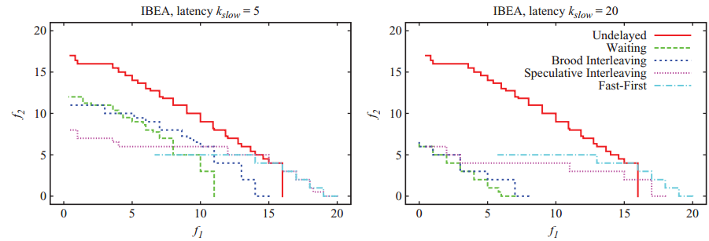
Optimization performance affected by:
Difference in evaluation times
Correlation between objectives
Search space characteristics
Little difference in evaluation time
Significant difference in evaluation time
Leading ones trailing zeros problem
Median attainment surface for a fixed delay period. Objective f₁ is the quick to evaluate objective.
Strategies that focus too much on improving fast objective suffer bias but are more likely to converge to (a part of the) Pareto front.

Slide 53
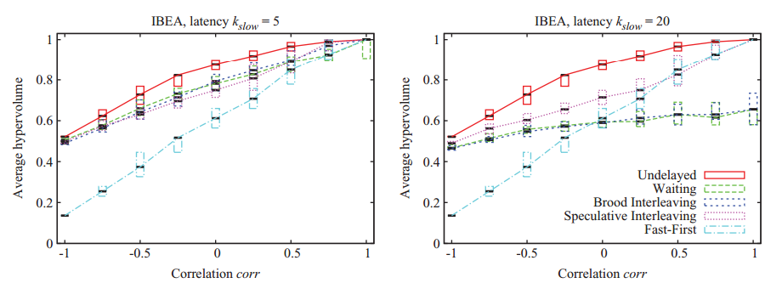
Optimization performance affected by:
Difference in evaluation times
Correlation between objectives
Search space characteristics
Little difference in evaluation time
Significant difference in evaluation time
Bi-objective OneMax problem adjusted to control correlation
Average hypervolume as a function of the correlation level between two objectives – fixed delay period.
Waiting performs well if different in evaluation times is little regardless of correlation levels. Non-waiting strategies perform well if objectives are positively correlated and evaluation differences large.

Slide 54
Objectives with different evaluation times
Possible extensions of this work
More focus on surrogate-assisted optimization strategies
Account for correlations between objectives to drive search
Many-objective problems with tuneable correlations between objectives
Account for non-homogenous experimental costs (in addition to non-homogenous evaluation times)

Slide 55
Agenda
Overview of active research projects
Experimental optimization (EO)
What is EO?
Some application domains
Some challenges of EO in biology and medicine
Change of variables during search
Objectives with different evaluation times
Handling ephemeral resource constraints
What is next?

Slide 56
What’s next?
Experimental optimization problems feature a range of non-standard challenges
More work needs to be done to understand how these challenges affect search and how to deal with them more efficiently
Almost no research on combination of multiple challenges
Future research directions beyond experimental optimization:
Explainable AI
New application areas, e.g. LegalTech

Slide 57
Thanks!

Slide 58
Experimental optimization in biology and medicine
Evolution of real DNA on microarray chips
Dealing with a very large population size
Landscape analysis / optimizing evolution
Drug discovery and medical microchipping
Change of variables during search
Objectives with different evaluation times
Lethal environments
Optimizing the design of analytical equipment
Handling ephemeral resource constraints

Slide 59
Motivation: Automation of science experiments
Mass spectrometers optimized by ParEGO were used in the HUSERMET project, a large study of human blood serum in health and disease with over 800 patient subjects and performed in collaboration with GlaxoSmithKline, AstraZeneca, Stockport NHS Trust and others (Bradbury et al, 2014)
Bradbury, James, Grégory Genta-Jouve, J. William Allwood, Warwick B. Dunn, Royston Goodacre, Joshua D. Knowles, Shan He, and Mark R. Viant.. MUSCLE: automated multi-objective evolutionary optimisation of targeted LC-MS/MS analysis, Bioinformatics (2014): btu740.

Slide 60
LDI Spectroscopy: Optimizing “Flyability”
LDI = Laser Desorption Ionization
In LDI, a laser is fired at a sample, e.g. blood serum, to analyse it
The sample may be placed on a silicon matrix
Properties of the matrix and laser frequency determine how much/which compounds in the sample will “fly” into the mass-spectrometer when the laser hits them

Slide 61
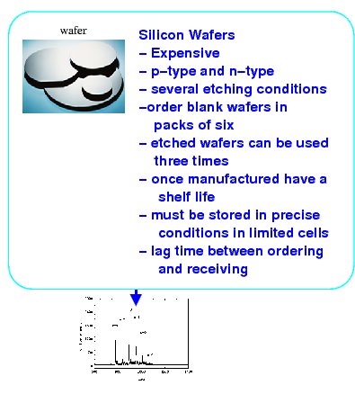
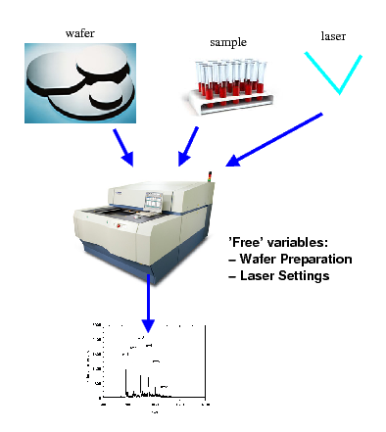
Optimize the Silicon Wafer Matrix

Slide 62
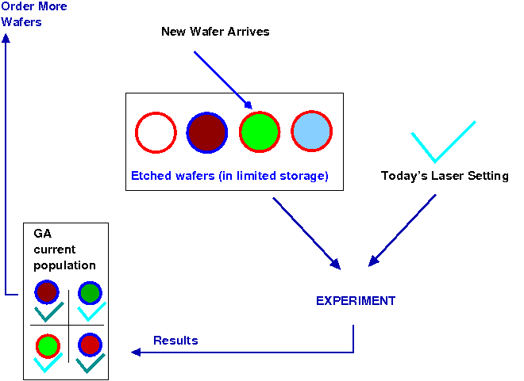
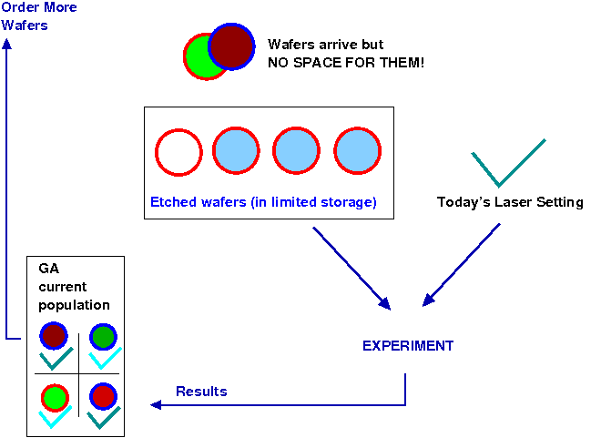
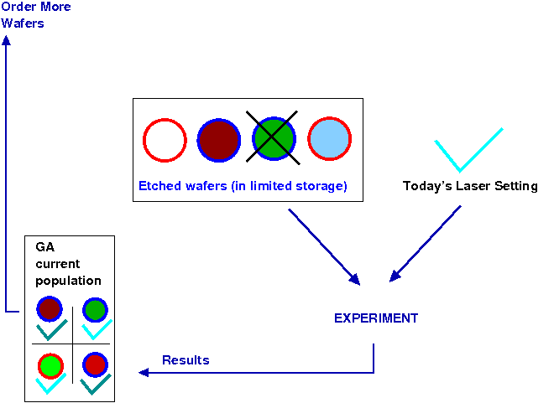
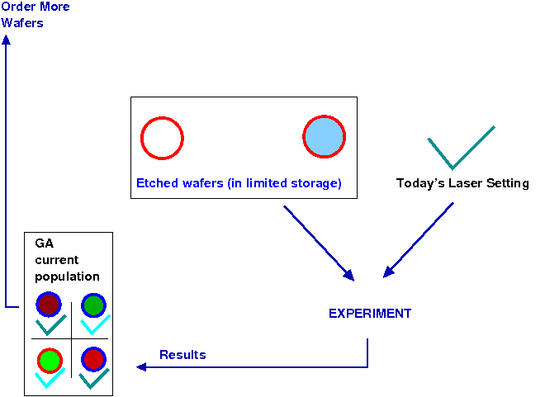
Optimize the Silicon Wafers
Model resource limitations using ephemeral resource constraints (ERCs)

Slide 63
Ephemeral Resource Constraints (ERCs)
Context:
Candidate solutions are evaluated using a real physical/chemical/biological experiment
Resources (e.g. humans, raw material, money, time, instruments, etc) are needed to conduct the experiment
Resources can temporarily be not available
Nr of experiments limited due to a fixed budget
What is the impact on optimization if certain resources are not available temporarily ?
→ Candidate solutions requiring these resources are temporality not available for evaluation → ERCs model this situation
R. Allmendinger and J. Knowles (2012): On Handling Ephemeral Resource Constraints in Evolutionary Search. Evolutionary Computation, 21(3): 497-531.
R. Allmendinger (2012): Tuning Evolutionary Search for Closed-Loop Optimization. PhD thesis. Department of Computer Science, University of Manchester, UK.

Slide 64
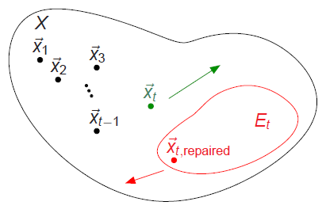
Ephemeral Resource Constraints (ERCs)
ERCs model availability (or unavailability) of resources and thus the evaluable search space
X - feasible search space
E_{t} ⊆X - evaluable search space
E_{t} can be defined in terms of (constraint) schemata, e.g. H = (*1**0)
R. Allmendinger and J. Knowles (2012): On Handling Ephemeral Resource Constraints in Evolutionary Search. Evolutionary Computation, 21(3): 497-531.
R. Allmendinger (2012): Tuning Evolutionary Search for Closed-Loop Optimization. PhD thesis. Department of Computer Science, University of Manchester, UK.

Slide 65
Ephemeral Resource Constraints (ERCs)
ERCs raise many questions:
Who/what is in control ?
How to mesh scheduling with optimization
How to prevent diversity loss/drift effects
How to reduce wastage of materials
Many examples of ERCs available due to the complex nature of resources
We have developed a taxonomy and framework to describe and simulate different realistic types of ERCs
R. Allmendinger and J. Knowles (2012): On Handling Ephemeral Resource Constraints in Evolutionary Search. Evolutionary Computation, 21(3): 497-531.
R. Allmendinger (2012): Tuning Evolutionary Search for Closed-Loop Optimization. PhD thesis. Department of Computer Science, University of Manchester, UK.

Slide 66
Ephemeral Resource Constraints (ERCs)
Periodic ERC
Models availability of a specific resource (defined by the constraint schema) at regular time intervals
E.g. “In an optimization problem requiring skilled engineers to operate instruments, on Mondays, only engineer eng_{i} is available.”
If eng_{i} is required for setups 1 to 3, and setups are indicated by the 1st variable (out of 5), then H = (1****) v (2****) v (3****)

Slide 67
Ephemeral Resource Constraints (ERCs)
Commitment relaxation ERC
Commits an optimizer to a specific variable value combination for some period of time whenever it uses this particular combination,
E.g. “In an optimization problem involving the selection of instrument settings, the configuration, c, once set, cannot be changed during the remainder of the working day.”

Slide 68
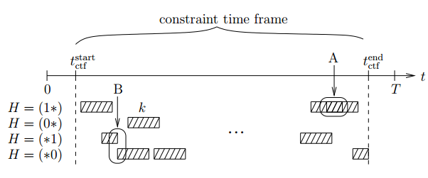
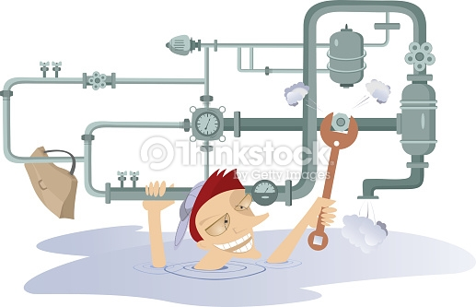
Ephemeral Resource Constraints (ERCs)
Random ERC:
A random ERC models the temporary non-availability of randomly selected resources

Slide 69
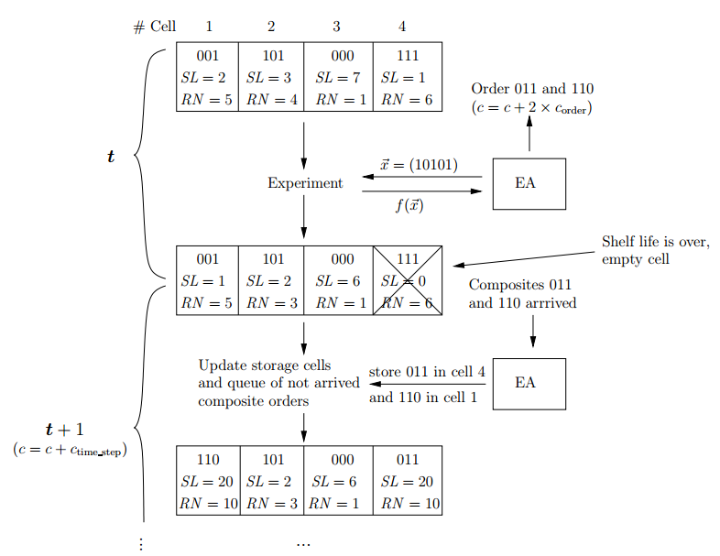
Ephemeral Resource Constraints (ERCs)
H# = (###**)
Commitment composite ERC:
Decision variables define a composite (a constraint schema) that requires resources to be available to evaluate solution.
Limited storage cells
Time-lag between ordering and receiving resources
Resources have shelf life and limited reuses
Silicon wafer example

Slide 70
Ephemeral Resource Constraints (ERCs)
Investigated various approaches to deal with ERCs, e.g.:
Static constraint-handling strategies (Allmendinger and Knowles, 2012)
Learn policies (via RL) to switch between constraint-handling strategies during optimization (Allmendinger and Knowles, 2011)
Optimization combined with online resource purchasing strategies (Allmendinger and Knowles, 2010)
Theoretical studies on ERCs can guide choice of EA configurations (Allmendinger and Knowles, 2015)
More work needed on combining ERCs with other experimental challenges e.g. noise, multiple objectives, non-homogeneous experimental costs.
R. Allmendinger and J. Knowles (2010): On-Line Purchasing Strategies for an Evolutionary Algorithm Performing Resource-Constrained Optimization. Parallel Problem Solving in Nature - PPSN XI , pp 161-170.
R. Allmendinger and J. Knowles (2011): Policy Learning in Resource-Constrained Optimization. Proceedings of the 13th Annual Conference on Genetic and Evolutionary Computation (GECCO '11), pp 1971-1978.
R. Allmendinger and J. Knowles (2012): On Handling Ephemeral Resource Constraints in Evolutionary Search. Evolutionary Computation, 21(3): 497-531.
R. Allmendinger and J. Knowles (2015): Ephemeral Resource Constraints in Optimization. In R. Datta and K. Deb (Eds.) Evolutionary Constrained Optimization, Springer, pp 95-134.

